Slide 1

Enhancing
Work Zone Safety

Slide 2

Overall Goal
Prevent work zone crashes, injuries and deaths on Kentucky roadways.

Slide 3
Work Zone Incidents January 1 - July 31
Year | Crashes | Injuries | Fatalities
2024 | 765 | 98 | 2
2023 | 1,230 | 132 | 15
2022 | 1,040 | 132 | 6
2021 | 1,285 | 138 | 9
2020 | 908 | 101 | 5
2019 | 1,225 | 131 | 5
Work zones: Construction, Maintenance/Utility, Non-Highway
Data: January 1 - July 31
2024 – reduction in crashes, injuries and fatalities
  2 fatalities
    versus 8 average
  98 serious and non-serious injuries
    Versus 127 average
  765 crashes
    Versus 1,138 average

Slide 4
Work Zone Incidents August 1 – December 31
Work zones: Construction, Maintenance/Utility, Non-Highway
Data: August 1 - December 31
Projections based on previous years
604 crashes on average (2019-2023) resulting in
  5 fatalities on average
  14 serious injuries on average
  56 non-serious injuries on average
Year | Crashes | Injuries | Fatalities
2023 | 724 | 80 | 8
2022 | 535 | 79 | 2
2021 | 664 | 67 | 5
2020 | 493 | 58 | 4
2019 | 604 | 65 | 6

Slide 5


Objectives of Automated Enforcement
Save Worker and Traveler Lives
Reduce Speeds in Work Zones
Improve Driver Behavior
Complement Existing Enforcement by KY State Police
Promote Work Zone Safety

Slide 6
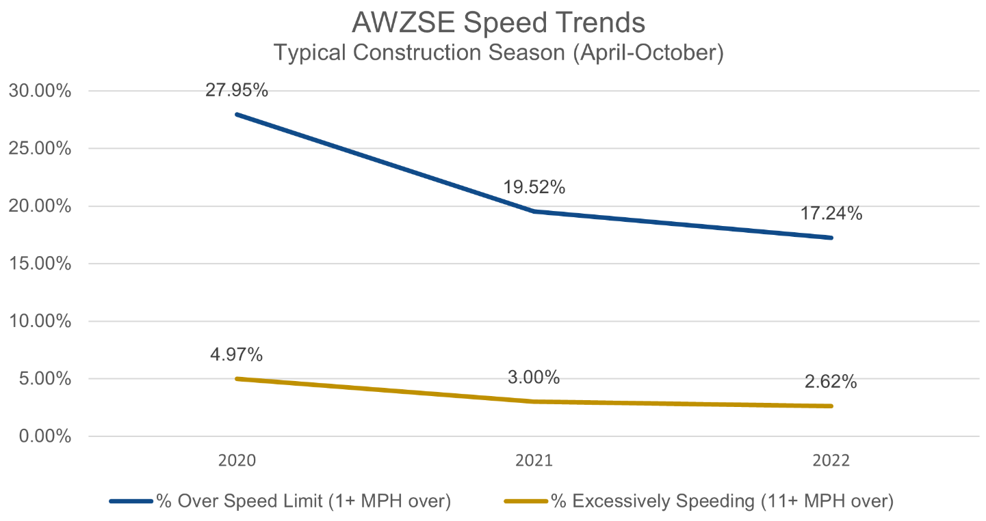
Pennsylvania’s Construction Season Trend

Slide 7
Data from Pennsylvania DOT
Four years prior to activation in 2020 – 29 fatalities
Four years after activation 2020-2023 – 1 fatality
This is not a revenue generator
Likely will cost $500,000 in first year

Slide 8
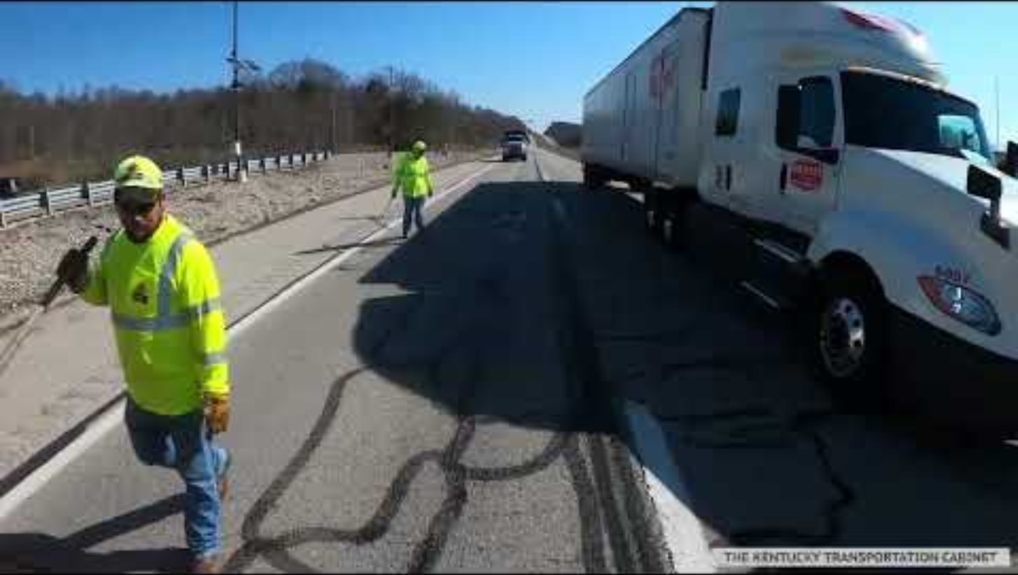
Hair-Raising Point of View of Crews
Notes:
YouTube link - https://youtu.be/gKJPjdnmNoA?si=sx1H8dRMSa1C97b9
KYTC link - https://transportation.ky.gov/HighwaySafety/Videos/Work%20Zone%20POV%203.0.mp4

Slide 9
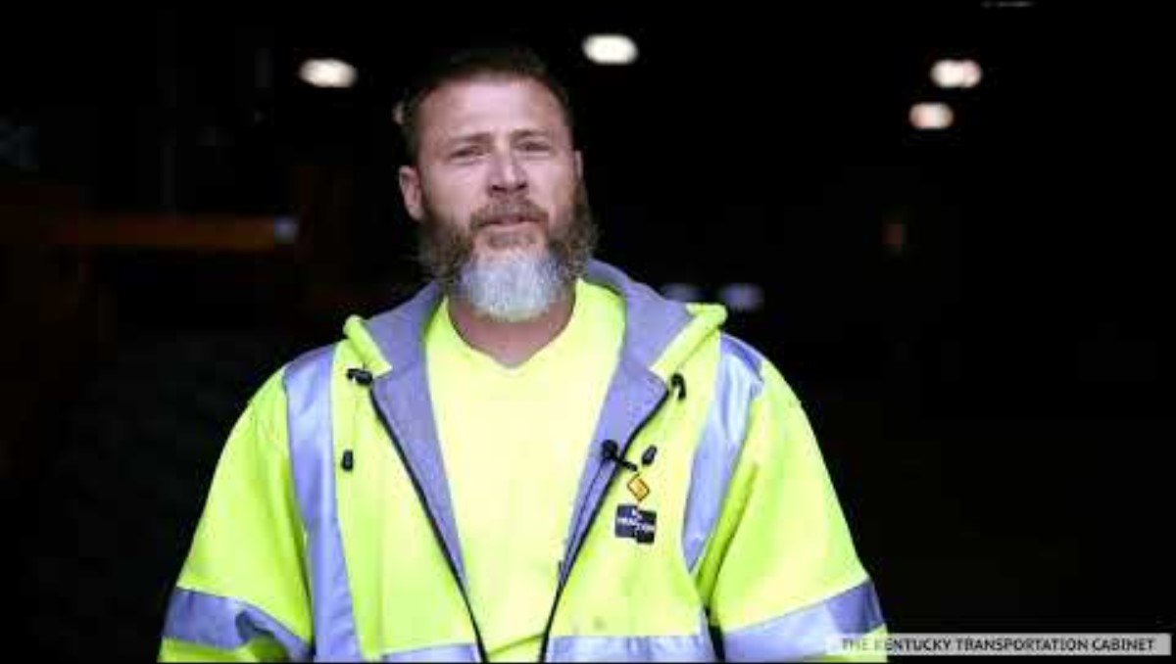
Mike’s Work Zone Story
Notes:
YouTube link - https://youtu.be/-xWX7jLcy1Q?si=bNJOtF05X_bOjUG7
KYTC link - https://transportation.ky.gov/HighwaySafety/Videos/mike%20mitchell%20video.mp4

Slide 10
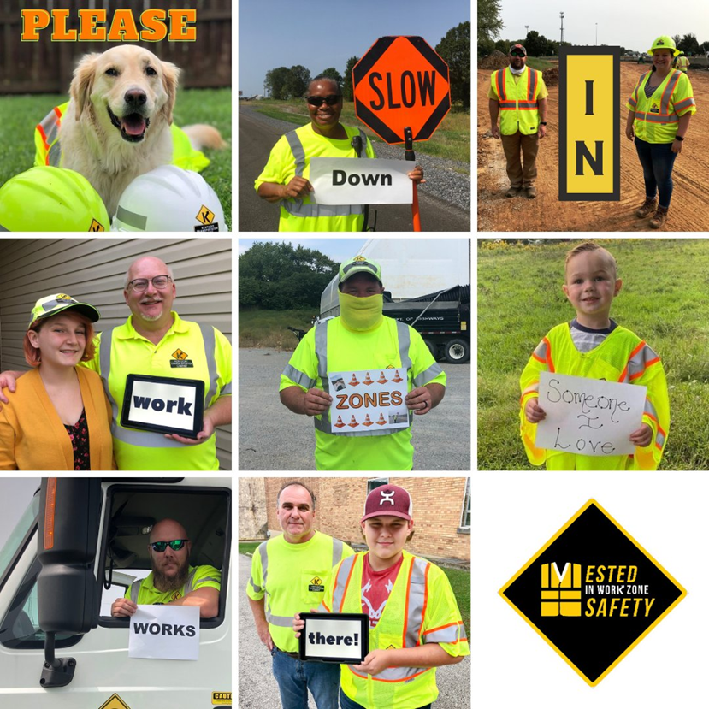

Questions?
Bill Bell, Executive Director
Kentucky Office of Highway Safety
502-352-8631 bill.bell@ky.gov

