Slide 1


Slide 2


What is Vision Zero?
Eliminate all traffic fatalities and serious injuries while increasing safe, healthy, equitable mobility for all.

Slide 3
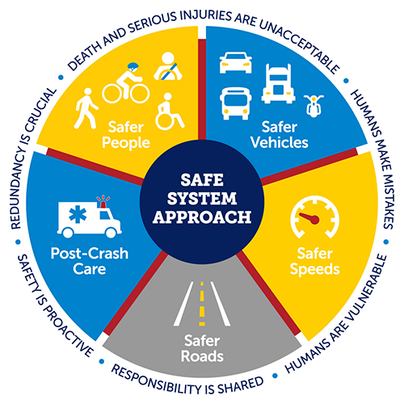
Vision Zero Louisville
Our vision is zero roadway deaths by 2050.
We follow the USDOT-recommended Safe System Approach to help us get there.
Photo credit: USDOT: What is a Safe System Approach?
Notes:
In June of 2022, Louisville Metro Council voted unanimously to adopt an ordinance in support of Vision Zero. Cities can establish their own benchmarks based on their own unique needs and transportation systems. Louisville’s goal is to eliminate traffic fatalities by 2050. Like in most U.S. cities, this goal excludes fatalities that occur on interstates and private property, such as parking lots. The ordinance requires an annual report be published documenting the needs and progress of our city’s Vision Zero initiative.

Slide 4
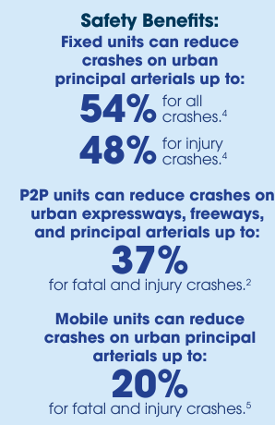
Why Speed Safety Cameras?
They work. Studies show they are proven to reduce fatal and serious injury crashes, the focus of Vision Zero.
Speeding increases the frequency and severity of crashes.
Need to manage speeds – especially in school zones and highway work zones.
Recommended by the Federal Highway Administration.
Data, photo credit: Federal Highway Administration: Proven Safety Countermeasures

Slide 5
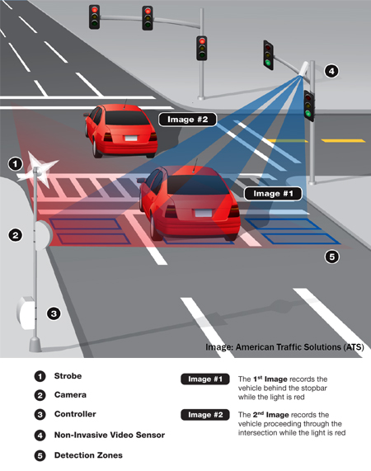
Why Red Light Cameras?
Proven to reduce red light running.
Study found 21% reduction in fatal red light running crash rate in cities with cameras compared to those without.
Over 300 communities in the U.S. operate red light camera programs.
Supported by National Safety Council, Governors Highway Safety Association, AAA, and more.
Data source: IIHS: Red light running. | Photo credit: City of Seattle

Slide 6
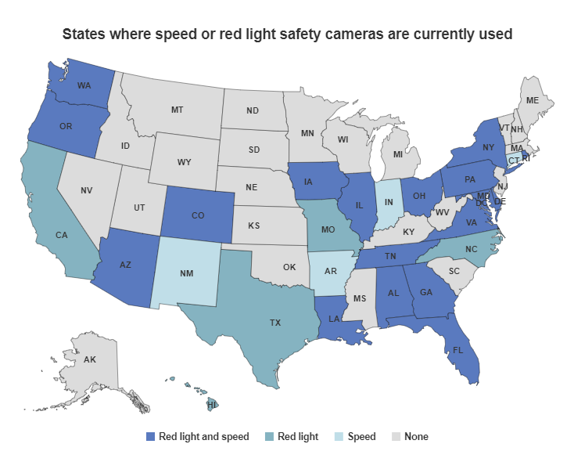
Why Automated Enforcement?
Proven to prevent fatal and serious injury crashes.
Focus on most egregious offenders.
Reduce societal cost of crashes.
Reduce burden on first responders.
Photo credit: IIHS: Red light running
Notes:
There is significant research and guidance on how best to design an automated enforcement program.
Programs should be transparent and seek only to achieve the desired outcome – which is reducing fatal and serious injury crashes – rather than generate revenue.
All violations should be reviewed by a law enforcement officer. In Louisville, our transportation agencies already have a strong working relationship with LMPD’s Traffic Unit.
Driving is a privilege, not a right.
Driving is a regulated activity.

Slide 7
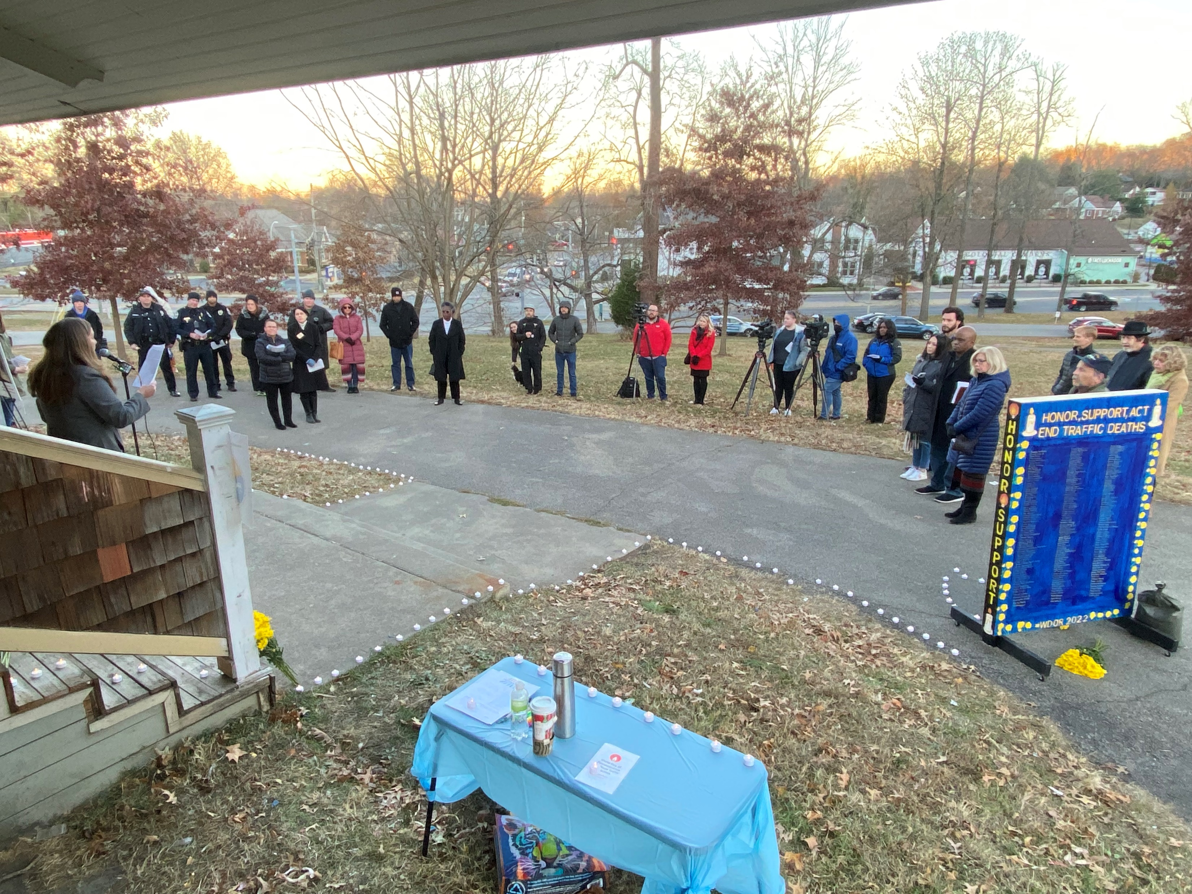
Support for Automated Enforcement
At least 10 bills filed in the past five years.
Bipartisan support for automated speed enforcement in highway work zones.
Louisville Metro Council passed resolution in support of red light cameras (2022)
World Day of Remembrance for Road Traffic Victims (2022, 2023)
World Day of Remembrance for Road Traffic Victims, Louisville, KY, 2022

