Slide 1
KAVIS Program Update
Transportation Committee
Report by Heather Stout
August 2024

Slide 2
Agenda
2023 vs 2024 Comparison Numbers
Rebuilt Progress Update
System Improvements and Prioritization

Slide 3
Comparisons 2023 vs 2024
2023 (AVIS)
State Total collected YTD
  $936,182,734.73
Checkouts
  2,552,448
Ad-valorem Collection
  $385,863,403
2024 (KAVIS)
State Total collected YTD
  $938,705,393.90
Checkouts
  2,653,601
Ad-valorem Collection
  $405,141,055
YTD numbers are January 1st through Aug 9 for 2023 and 2024

Slide 4
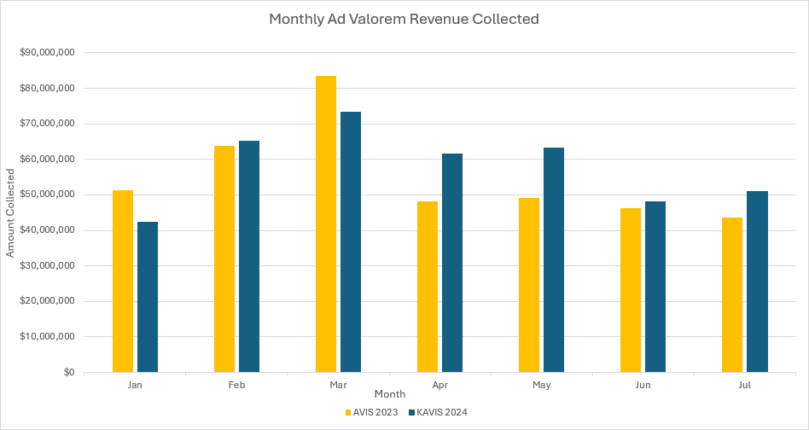
Monthly Ad Valorem Collected
Notes:
Monthly Ad Val Collections 2023/2024
Total AVIS 2023=$385,863,403.05
Total KAVIS 2024=$405,141,055.52
KAVIS collected $19,277,652.47 more in 2024
Stabilization for KAVIS was felt in the first quarter of the year. As the application was enhanced and users became more adept in the system, the ability to collect and transact increased.

Slide 5
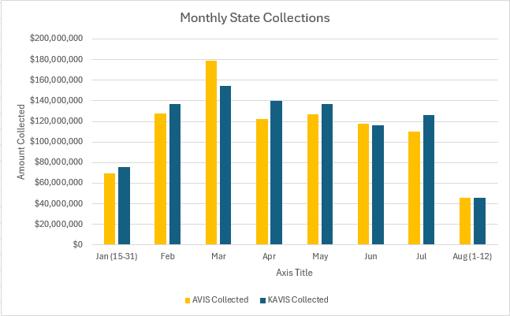
Monthly State Collections
Notes:
Monthly State Collections 2023/2024
Monthly breakdown of 2023 AVIS to 2024 KAVIS
Starting the first week KAVIS was live
January was a ramp up month for KAVIS 2024; AVIS was fully live in 2023
March is the highest transaction and collection month of the year for the clerks
From Jan 15 to present, KAVIS has collected $34,491,095 more in 2024 than in 2023. This is due to KAVIS’ central architecture focused on data and decision integrity, collaborative and consolidated application design as well as the customer centric model.

Slide 6
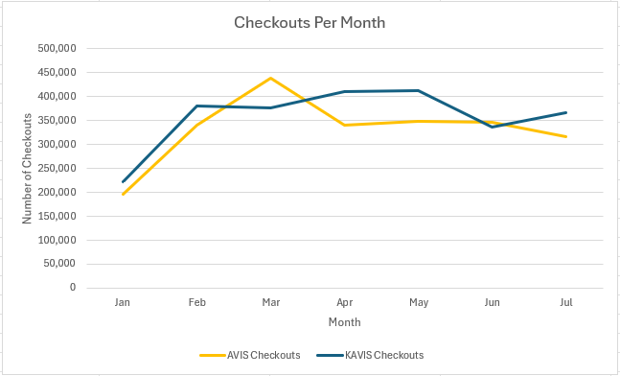
Monthly Checkouts
Notes:
Monthly Checkouts 2023/2024
Number of checkouts performed by clerks each month
This measures the ability to process work
Throughput is a key success factor in the clerks’ offices
Transactions increased as KAVIS stabilization occurred

Slide 7

Rebuilt
We are now within the five day turn around established by statute
New procedure for dealer submitted rebuilt applications
This is processed in one step after approval, instead of three steps
Dealer receives a “speed” paper title already DA to permit account
Continue to develop improvements to our internal processes

Slide 8
System Improvements
Completed:
Bulk Transactions
  Clerk suggested enhancements to the bulk processing page.
Legislative Updates
  2024 Legislation
    10K plate to birth month
    Reinstatement Fee
  Edit Actions; Edit "in-flight" transactions
  Allows editing of data while processing
  Increased flexibility
  Reduced guardrails and validations
  Rebuilt Process Enhancements
On-Going:
Data Cleanup
  Continue running cleanup scripts as issues are identified
Enhancements-Speed, Efficiency
  Business process flow enhancements for larger counties
  Transaction Reversal updates
Reporting
  Continue to improve and increase report options

Slide 9
Prioritized System Improvements
Clerk Efficiency Enhancements:
  PODD Receipt Printing Order
  Fleet Management – High volume Customer Account screens
  Bulk Processing Autosave
  Reactivations for titles 2+ yrs
Legislative Changes:
  KY Electronic Lien and Titling
  Electric Vehicles
  Autonomous vehicle flag
  Electronic Sheriff Inspections (HB 833)
  New Special Plates
Centralized Lien Management
PVA/DOR Valuation
BTR/VTR
KSP/LINK/NCIC Improvements
Insurance Improvements

Slide 10
Collections in Top 10 Counties
County Name | Amt Collected 2023 | Amt Collected 2024 | Difference
Jefferson | $153,779,539.65 | $155,364,926.68 | $1,585,387.03
Fayette | $68,174,703.66 | $69,710,779.98 | $1,536,076.32
Boone | $32,426,767.09 | $32,980,184.35 | $553,417.26
Kenton | $30,944,827.30 | $32,483,464.27 | $1,538,636.97
Warren | $30,787,047.85 | $31,428,930.51 | $641,882.66
Hardin | $24,850,892.33 | $25,199,279.22 | $348,386.89
Madison | $21,456,621.59 | $23,035,896.98 | $1,579,275.39
Daviess | $20,024,683.22 | $20,668,047.77 | $643,364.55
Pulaski | $19,286,170.16 | $19,493,776.16 | $207,606.00
Oldham | $17,369,667.63 | $18,798,585.85 | $1,428,918.22

