Slide 1
INTERIM JOINT COMMITTEE
ON TRANSPORTATION
September 17, 2024
KYTC’s Use of Recycled Asphalt
John Moore, PE, Deputy State Highway Engineer
Department of Highways
Tracy Nowaczyk, PE, Assistant State Highway Engineer
Department of Highways

Slide 2
Two-Year Budget Bill
Recycled Asphalt Products: The Transportation Cabinet shall not restrict the use of recycled asphalt products for any asphalt mixture used on a project, provided that the asphalt mixture meets the established performance criteria. The Transportation Cabinet shall report on the percentage of recycled asphalt products used in state projects to the Interim Joint Committee on Appropriations and Revenue on or before November 1, 2025.
It is the intent of the General Assembly that by 2030, the Transportation Cabinet shall use an asphalt mixture that utilizes 30 percent or greater recycled asphalt products.

Slide 3
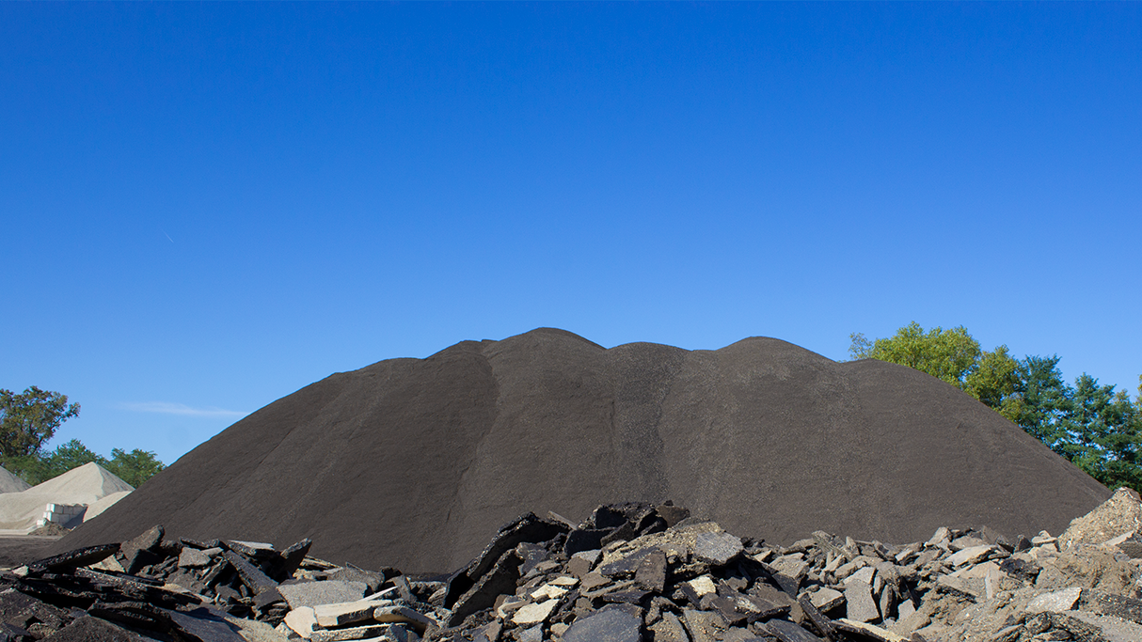

We All Have Common GOAL:
Increase the % of RAP used in Kentucky
  Right %
  Done Responsibly

Slide 4

We All Have Common Goal of Increasing RAP
Provide safe and reliable roads
Optimize the budget
Protect environment and provide stewardship
Viewed as industry leader

Slide 5
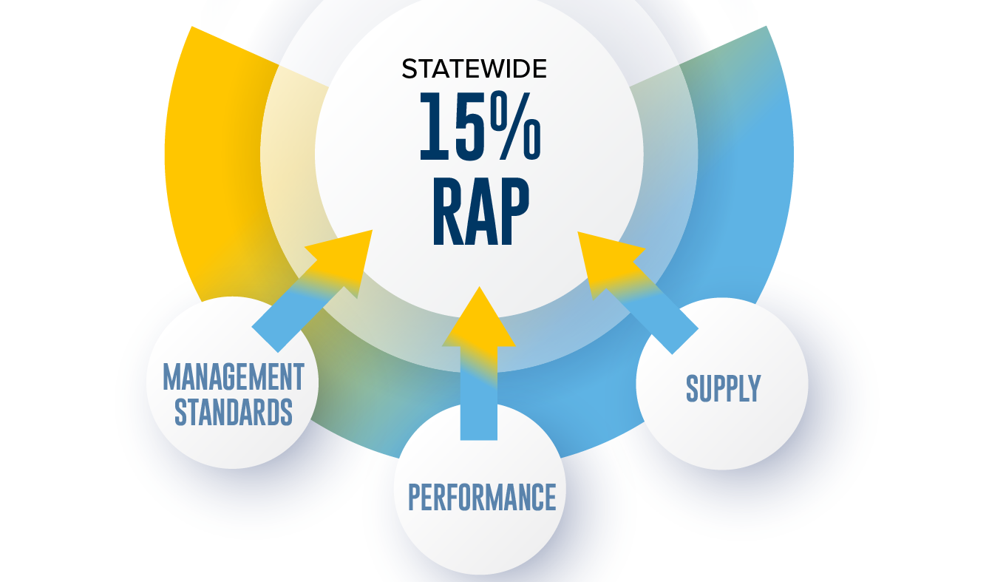
Three Factors Impact Current RAP Usage

Slide 6
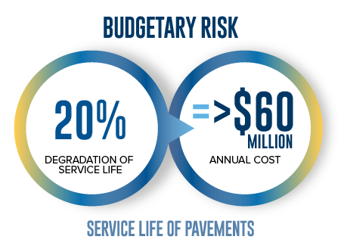
KY Performance Metrics Reveal RAP Limitations
Increased % of RAP used without proper quality measurements can lead to unsafe roads
KY data shows 15+% RAP in surface layer pavement tends to crack and deteriorate faster
RAP not shown to increase buying power and has significant downside if causes premature cracking, rutting and wear

Slide 7

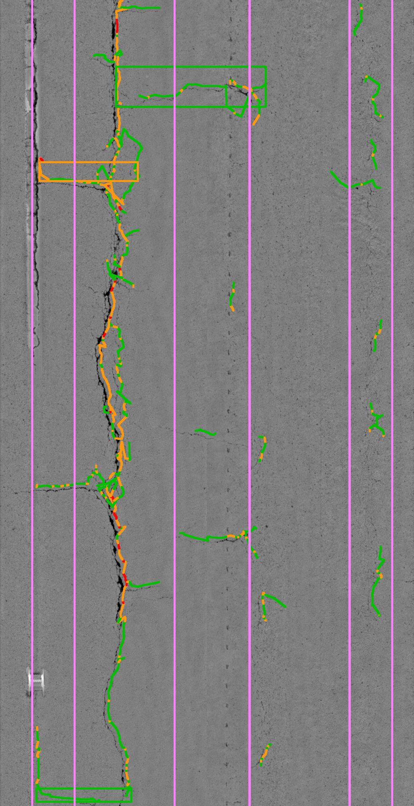

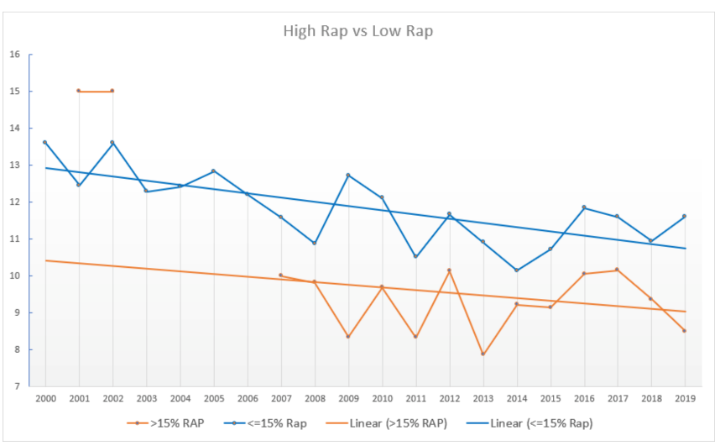

Data Drives Decision-Making Process
Pavement Preservation System
  20 years of data
  Now an industry-standard nationwide

Slide 8
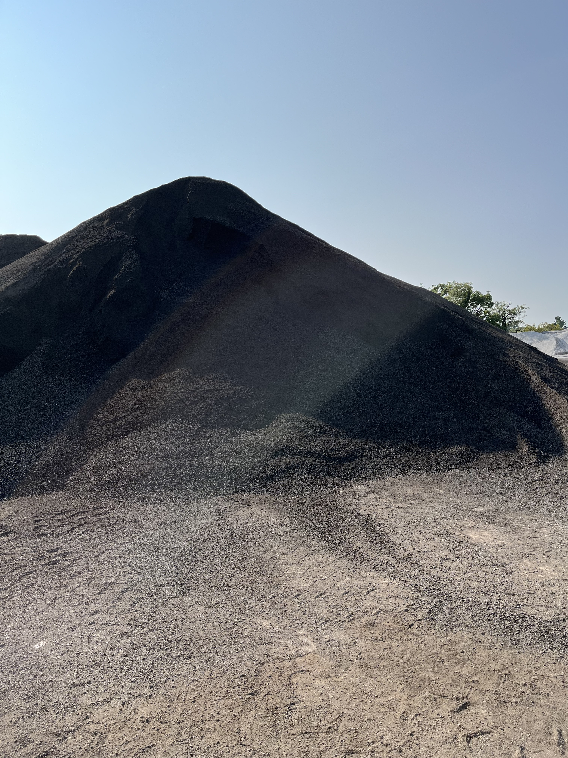

Management Standards Needed for Quality and Cost Containment
Standards for RAP mix are critical
Inventory management is challenging
Overhead costs associated with RAP are high
Managed RAP
Unmanaged RAP

Slide 9
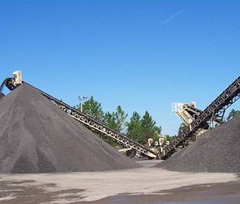
RAP Supply Variability
Geography of urban vs. rural is a challenge
Varying capabilities of contractors

Slide 10
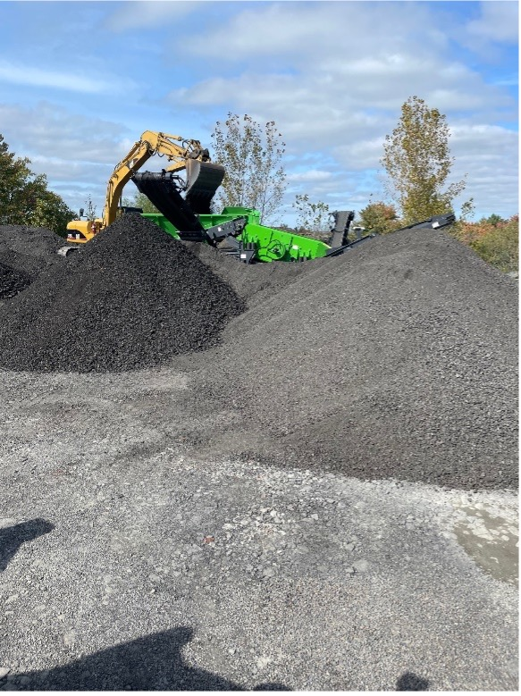





Our Process to Achieve “Right” RAP %
Draft Performance Criteria to create standardization
  Implement RAP Stockpile Management Plan
  Refine Specifications
  Establish Performance Tests
Conduct road trials with variations of factors
Partner with industry to optimize technology and benchmark best practice

Slide 11
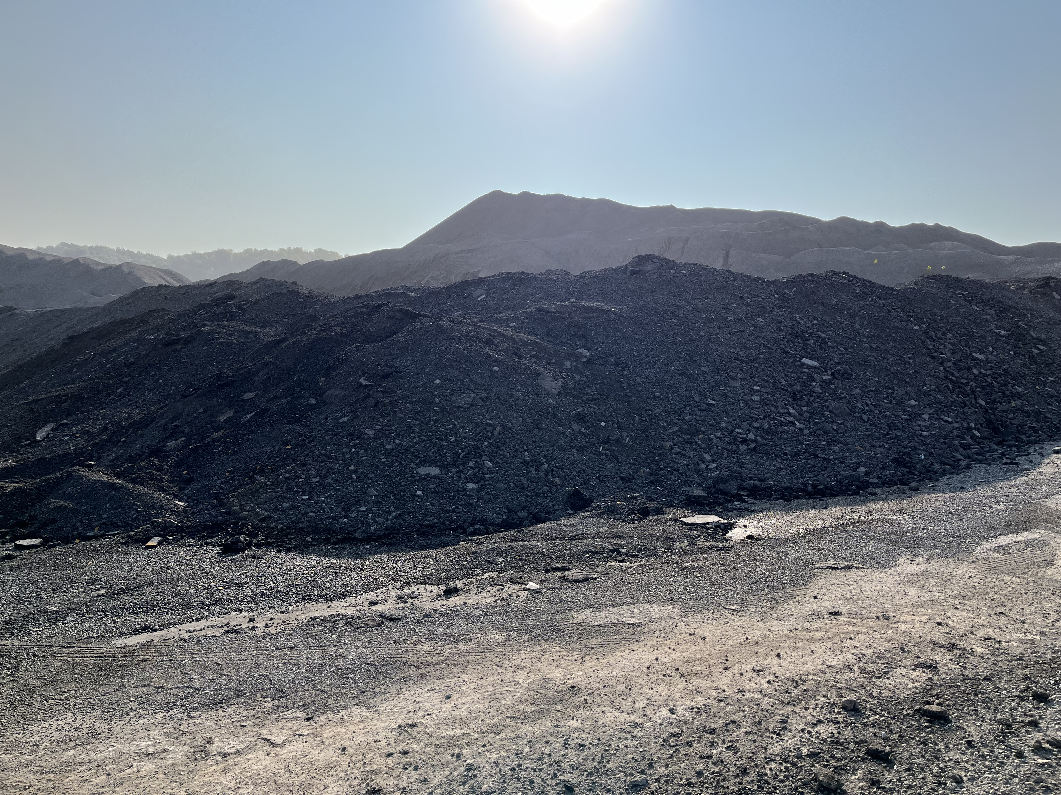
Next Steps
Formalize and adopt performance criteria testing and best practice guidelines to ensure consistent mix performance
Start pilot projects (field in place verification)
Continue to look at new technology with industry partners to improve performance

Slide 12
Questions…
John Moore, PE, Deputy State Highway Engineer
Department of Highways
Tracy Nowaczyk, PE, Assistant State Highway Engineer
Department of Highways

