Slide 1
INTERIM JOINT COMMITTEE ON TRANSPORTATION
June 3, 2025
Local Assistance Road Program Update
Bobbi Jo Lewis, Commissioner Department of Rural and Municipal Aid

Slide 2
Local Assistance Road Program
The Local Assistance Road Program (LARP) sets out modified requirements and guidelines for the County Priority Projects Program (CPPP) in HB 546 from the 2025 Legislative Session.
Application Cycle opens June 1, 2025 - closes on October 1, 2025.

Slide 3
County Priority Projects Program HJR 46 (25 RS)
Implementation Status of HJR 46 (25 RS)
Preparing information for production of 106 MOAs from awards contained in HJR 46.
MOAs to be sent out for processing on or about 7/1/2025, when funding is available.

Slide 4
County Priority Projects Program FY 2025 & FY 2026
Implementation Status of Local Assistance Road Program
Updated application form includes LARP requirements:
a. Photos every 300 ft (17.6 per mile);
b. Project no more than $500,000;
c. Local Match required;
d. Must be rehabilitation projects (designed to restore original condition).
Reporting forms prepared and ready to capture required information as provided by local agencies.
Scoring Matrix has been developed by KYTC Highways staff to be utilized by all districts.

Slide 5
How Roads Are Scored
Evaluation is calculated using the following:
- Preservation of assets
- ADT (Average Daily Traffic)
- Recent Improvements (Yes/No)
- Safety
- Cost
- Priority ranking within the highway district

Slide 6
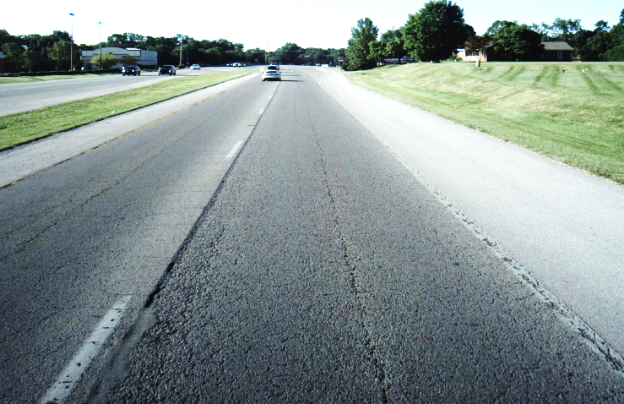
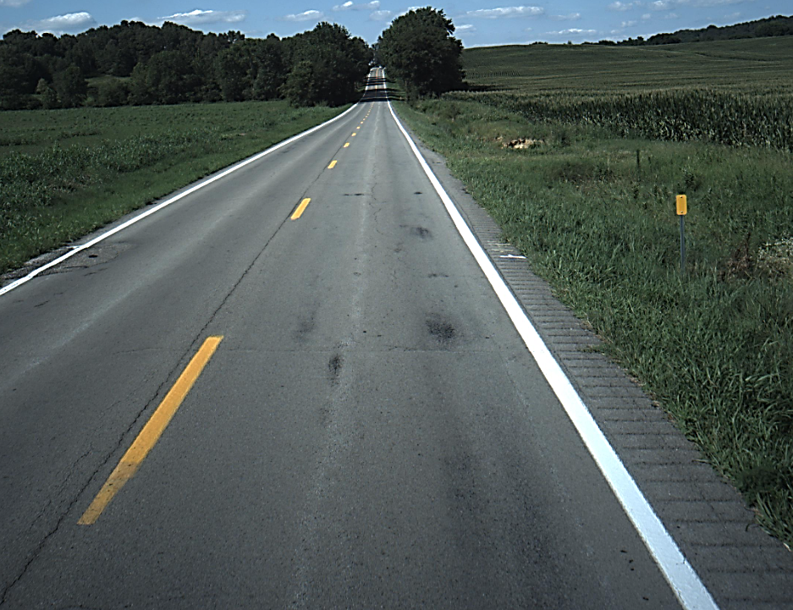
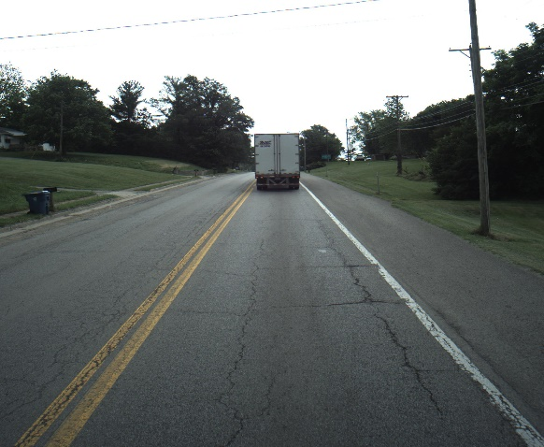
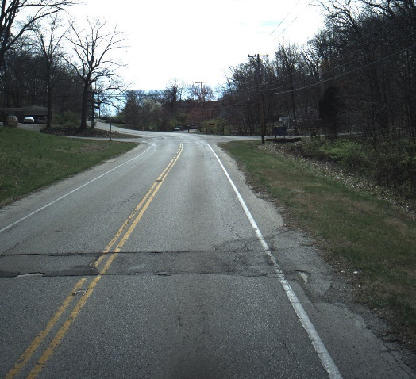
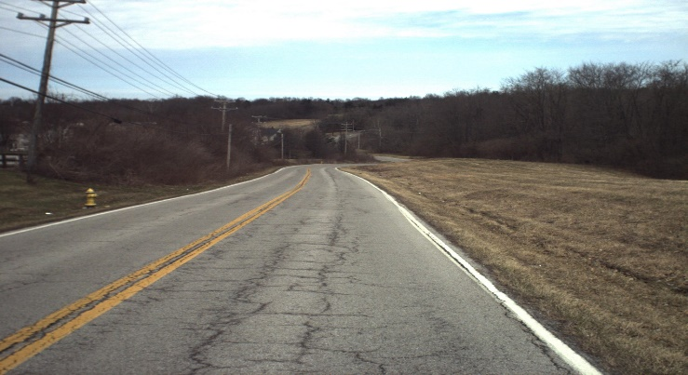
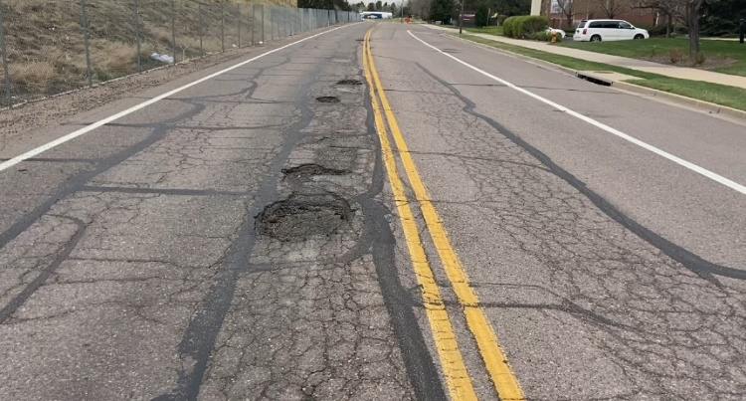
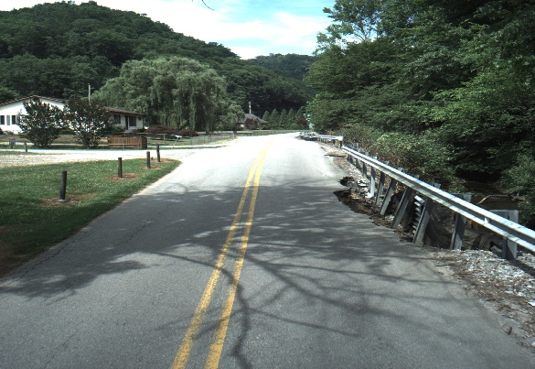
How Roads Are Scored: examples
RAVELING = Poor
RUTTING = Poor
LONGITUDINAL CRACKING = Poor
UTILITY CUTS = Poor
PATTERN CRACKING = Poor
POTHOLES – Number & Depth
BASE FAILURE - Number

Slide 7
County Priority Projects Program Funding FY 2025 & FY 2026
HJR 92 – FY 2025
- Funds set out in HB 265: $20,000.00
- Authorized in HJR 92: $17,290,000 ($19,991,000 less $2,701,000 for projects already completed)
- 34 Counties/Cities with Completed Projects & 7 Partially Completed, totaling: $10,024,438.02
- 30 Counties/Cities with Pending Projects: $6,985,120.92
- Underruns following final payments: $280,441.06 (these funds carry forward)
HJR 46 – FY 2026
- Funds set out in HB 546: $21,147,000
- Projects authorized in HJR 46: 23,857,000
($9,000.00 over-authorized leaving $271,441.06 for reauthorization)
- 89 Counties and 17 cities included for 149 projects

Slide 8
INTERIM JOINT COMMITTEE ON TRANSPORTATION
June 3, 2025
Local Assistance Road Program Update
Bobbi Jo Lewis, Commissioner Department of Rural and Municipal Aid
- QUESTIONS -

