Slide 1
INTERIM JOINT COMMITTEE ON TRANSPORTATION
June 3, 2025
Response to Recent Severe Weather Event in Southeastern Kentucky
Jim Gray, Secretary James Ballinger, State Highway Engineer

Slide 2
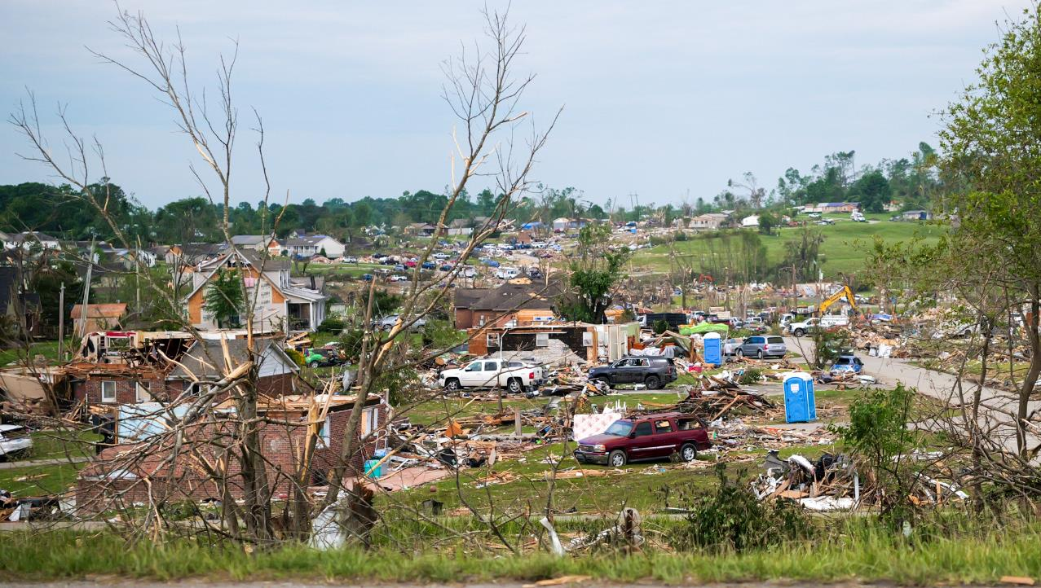

Slide 3
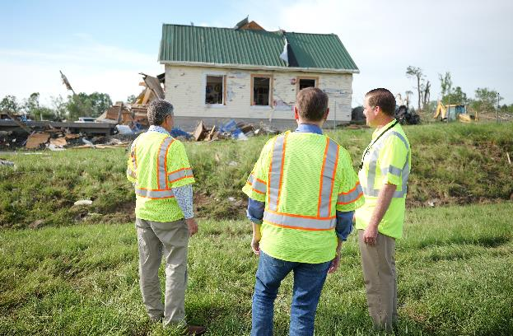
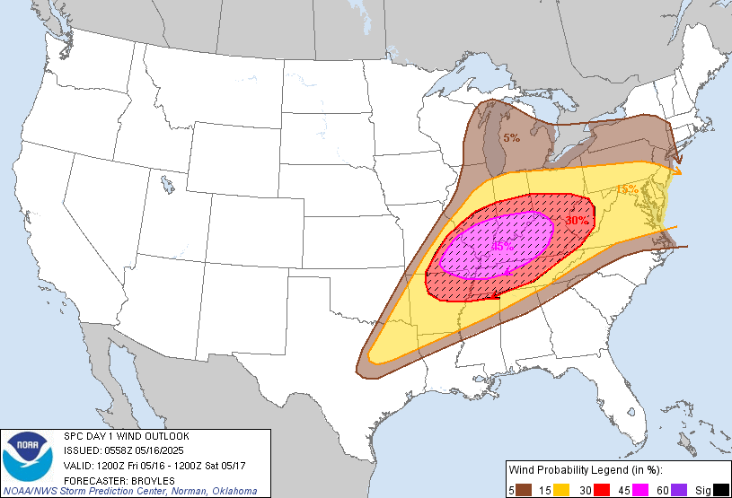
May 16-17 Severe Storms
6 confirmed tornadoes
19 fatalities

Slide 4


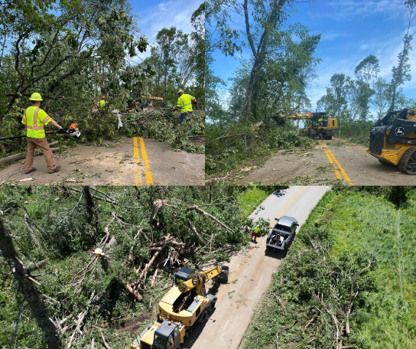


KYTC Response
Before storm, crews on call with equipment prepped
Most of 120 county crews Fri night > Sat responded to high wind damage: trees down, debris
~200 staff responded in Somerset and London
16+ hour days initially after storms

Slide 5
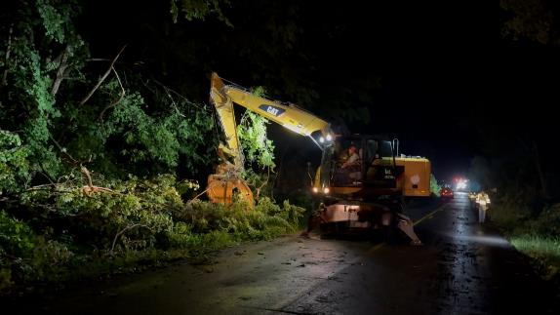
KYTC Response
Storm impacted all regions
Multiple roads blocked by debris in overnight hours, especially in western KY (Morganfield, Hopkinsville, Russellville); most cleared by Sat. morning
Crews west of I-75 mainly patrolled and cleaned up roadways through Saturday
Monitored flood prone areas and placed high-water signs where needed

Slide 6
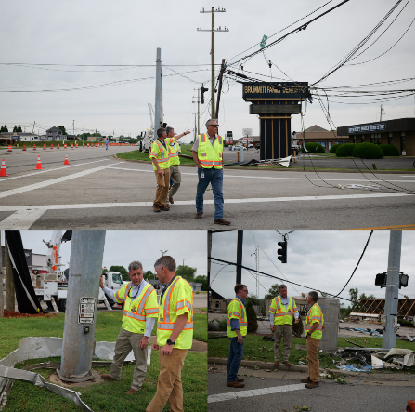
District 8- Somerset
EF-4 near Jamestown swept across Somerset into London
Crews mobilized to move hazards & close roads where needed in all 10 counties- most impacts in Pulaski
Several miles of KY 1003, KY 192, KY 1643, and KY 3269 had downed trees and powerlines
6 signals along U.S. 27 and KY 914 were out; restored signals with temporary power sources (1 signal off U.S. 27 remains down)
U.S. 27 closed for debris removal and power restoration (fully reopened May 23); repairs ongoing
Ongoing clearing along right of way; worked on five state highways this past weekend.
Notes:
Confirmed F4 tornado
Neighboring county crews supplemented response efforts and more than 80 crew members worked 16-hour days through the weekend; several highways remained closed by trees tangled in power lines, including U.S. 27 at Somerset where signals and poles were destroyed (U.S. 27 reopened on Wednesday, May 21, but repairs continue)
Crews from four other counties (Casey, Wayne, Rockcastle, McCreary) mobilized to assist Pulaski in opening roads. After their hard work through the night clearing roads in their home counties. By Saturday afternoon the five crews had cleared at least one lane of travel on all roads, and by Monday afternoon had cleared two lanes of travel on all state roads, preparing the way for the utility companies to restore power. Once the roads were cleared of debris KYTC coordinated with utility companies to close routes to expedite their efforts in restoring power.
KYTC work with local law enforcement, local city officials, and county government to extend and maintain the closure of U.S. 27 to again expedite the utility restoration and debris removal
Sec Gray visited site with James

Slide 7
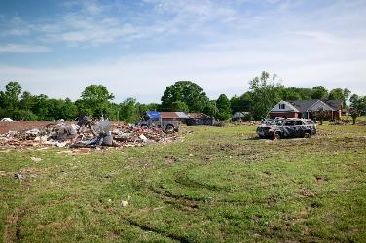
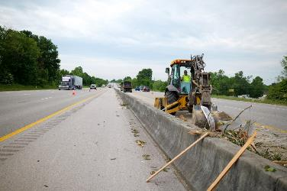
District 11- London
No highways closed
Worked with KSP to barricade several state routes to help with traffic flow
Staff cleared roads of trees and debris, addressed signal issues
Helped utility companies
Removed debris from I-75
KYTC staff transported water and meals to residents
Nic v- Neighborhood, I-75,

Slide 8
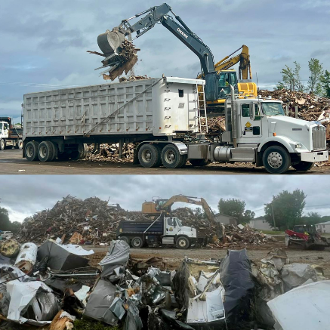



District 11- London
Continued coordination with KYEM, police, fire crews and local officials on cleanup and recovery
Counties are managing debris removal. KYTC crews assisting by hauling construction and demolition debris to identified sites.
Debris Hauled:
1,473 loads 7,746+ tons 15,492 cubic yards
Notes:
The County is managing and will be submitting the reimbursement paperwork to FEMA. We are working under a MOA with the County for debris hauling and collection. Basically we are acting as a contractor for them. At the end, we will submit documentation to the County for reimbursement directly and they will then submit to FEMA
Stats as of 5/29/25
The Kentucky Transportation Cabinet (KYTC) expresses its gratitude to all the volunteers, contractors, and local county and city government entities that have facilitated the collection of debris from the affected areas, enabling us to transport it to the Laurel Ridge Landfill.Although lots of work remains, KYTC is committed to continue working with County and City governments throughout the recovery process.

Slide 9
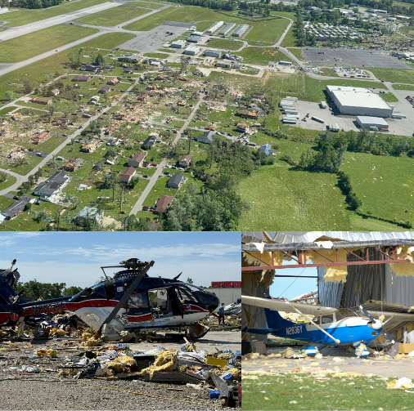
London/Corbin Airport
Closed May 17
Reopened May 19
District 11 staff and inmates from Jackson and Whitley counties helped with cleanup to reopen the runway

Slide 10
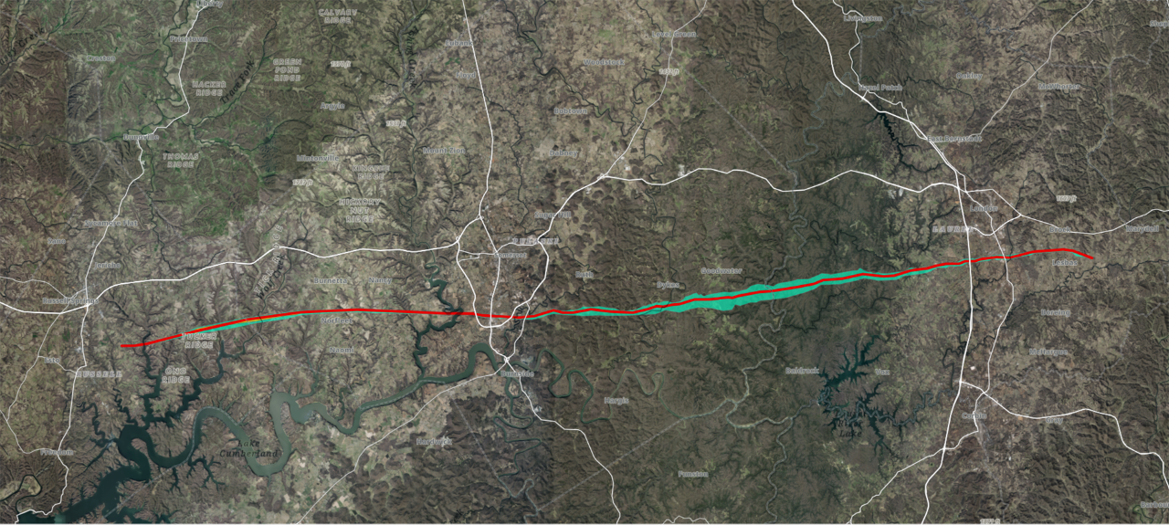
Tornado's Path

Slide 11
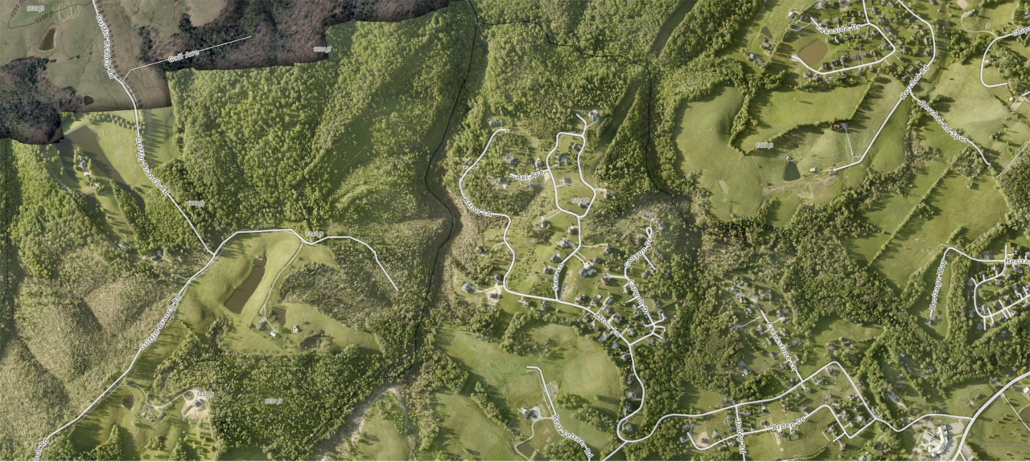
Canyon Drive

Slide 12
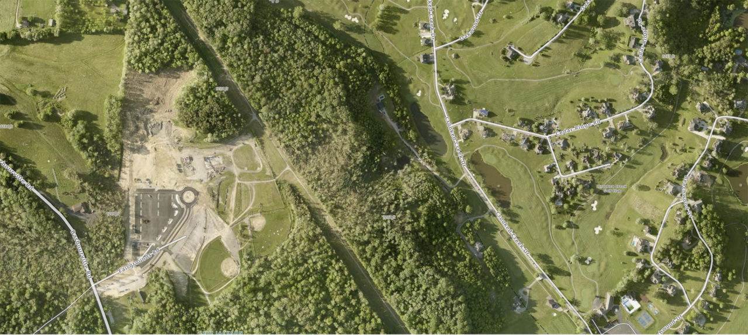
Fairgrounds & Crooked Creek

Slide 13
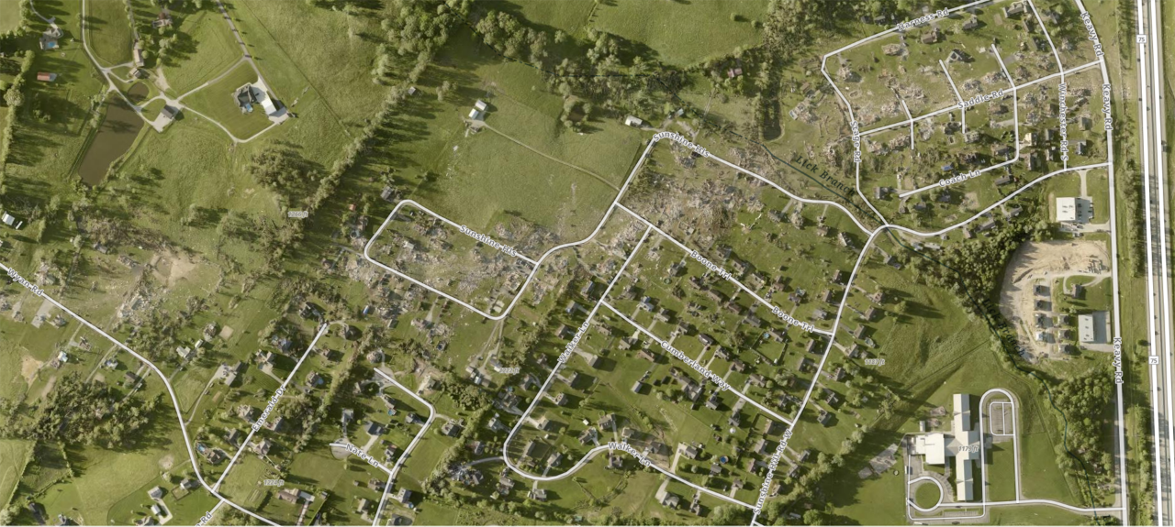
Sunshine Hill

Slide 14
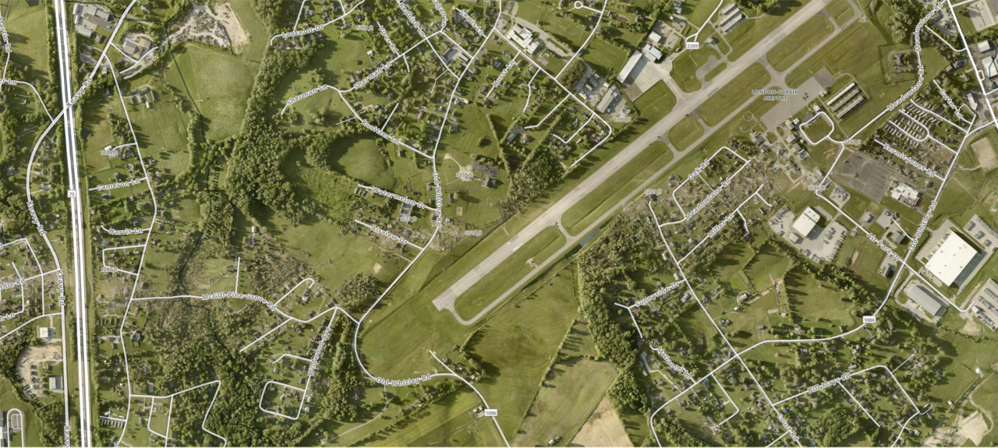
Airport

Slide 15
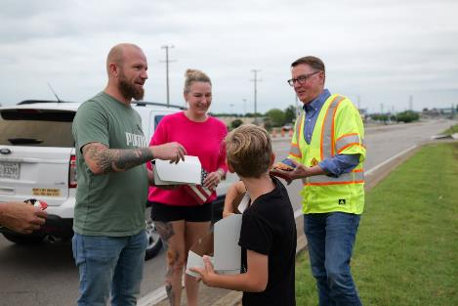
Helping Kentuckians Rebuild
Gov. Beshear signed executive order allowing duplicate licenses, IDs, vehicle registrations and titles to May storm survivors – at no cost
Team Kentucky Storm Relief Fund raised $1.5 million from 6,692 donors
Notes:
IDs and licenses can be replaced at Driver Licensing Regional Offices; vehicle registrations and titles can be replaced at county clerk offices
This exec order applies to residents of Caldwell, Christian, Laurel, Pulaski, Russell, Todd, Trigg, and Union counties, and any other county that’s included in a presidential major disaster area declaration or amended declaration during this month’s state of emergency
Donations raised as of 5/29/2025
KYEM has taken over management of travel trailer housing assistance so KYTC was not involved this time

Slide 16
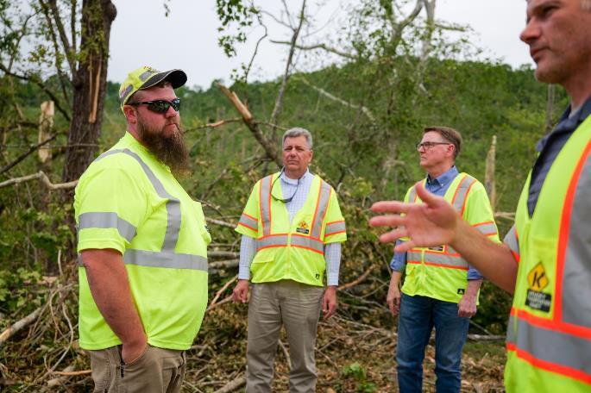
Heart to Serve- Tanner Burnett
Pulaski County Highway Technician II
Notes:
Tanner is an Highway Tech 2 in Pulaski Co. We met during our damage assessment visit to Pulaski County. He had a heavy equipment incident 2 years ago. He had to swerve and he rolled down a steep bank. Spent a few days in the hospital with cracked vertebrae. Two years later he is called out to the same road to clean a path and look for survivors on the same road. This was the location of the only fatality in Pulaski Co.
He was leading the way in the middle of a stormy night on a road that had painful memories – all part of his heart to serve his community.

Slide 17
INTERIM JOINT COMMITTEE ON TRANSPORTATION
June 3, 2025
Response to Recent Severe Weather Event in Southeastern Kentucky
Jim Gray, Secretary James Ballinger, State Highway Engineer
- QUESTIONS -

