Slide 1
INTERIM JOINT COMMITTEE ON TRANSPORTATION
August 18, 2025
Local Assistance Road Program Update
Bobbi Jo Lewis, Commissioner Department of Rural and Municipal Aid

Slide 2
RURAL SECONDARY ROAD NEEDS
Rural Secondary (“RS”) Program is funded by 22.2% of the motor fuels tax revenue.
Allocation is determined by the Fifths Formula.

Slide 3

REVENUE SHARE BREAKDOWN
RURAL SECONDARY ALLOTMENT
KRS 177.320
22.2% of motor fuel tax
Allocations established by Fifths Formula
Used for construction, reconstruction and maintenance of Rural Secondary Roads
Up to 6% allocated for RS emergency account
COUNTY ROAD AID ALLOTMENT
KRS 177.320
18.3% of the motor fuel tax for county roads
Allocations to counties established by Fifths Formula
Used for construction, reconstruction and the maintenance of county roads
3% allocated to the county emergency account
MUNICIPAL ROAD AID ALLOTMENT
KRS 177.36 & 177.366
7.7% of the motor fuel tax for urban roads and streets
Allotment per city determined by population
Used for construction, reconstruction and maintenance of city streets
3% allocated to the municipal emergency account

Slide 4
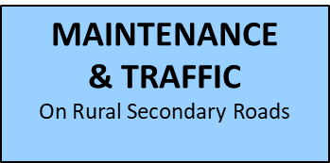
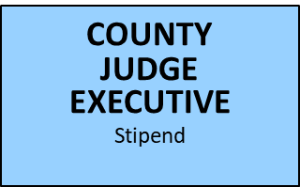
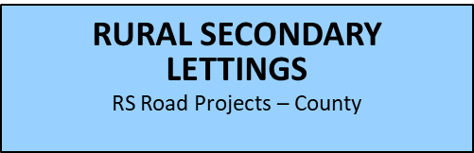

RURAL SECONDARY FUNDING BREAKDOWN
RURAL SECONDARY FUNDING
(KRS 177.320) 22.2% (CB06) = $190,831,200
INITIAL DISTRIBUTION
RS EMERGENCY FUND
(CB01)
Up to 6%
Funding allotment (90%)
(10% set aside)
State Emergencies
on Rural Secondary Roads
( ½ of 6%)
80/20
BRIDGE PROGRAM
(½ of 6%)

Slide 5
INFORMATION REQUESTED ON RURAL SECONDARY (“RS”) ROAD NEEDS
Anticipated additional funding needed to pave RS roads not paved for 15 years or more…
District 1 $50,332,250
District 2 $18,780,750
District 3 $15,000,000
District 4 $12,300,000
District 5 $14,292,023
District 6 $15,000,000
District 7 $18,000,000
District 8 $54,929,375
District 9 $24,147,995
District 10 $85,621,392
District 11 $ 4,407,865
District 12 $63,840,749
TOTAL $326,320,149

Slide 6
INFORMATION REQUESTED ON RURAL SECONDARY (“RS”) ROAD NEEDS
Current number of roads paved each year with the current RS budget…
District 1 5.00%
District 2 5.00%
District 3 2.96%
District 4 5.86%
District 5 6.35%
District 6 5.10%
District 7 5.30%
District 8 3.00%
District 9 5.50%
District 10 5.60%
District 11 5.66%
District 12 5.00%
**Answers are in percentages as the projects may consist of partial road repairs and resurfacing.

Slide 7
RURAL SECONDARY (“RS”) ROAD NEEDS
Considerations:
- RS funding may be used for: resurfacing and maintenance activities, all of which can have an appreciable impact on the information provided.
- A 15-year pavement cycle may not be appropriate in every case. Some roads require less than 15 years and some can last longer than 15 years.

Slide 8
INTERIM JOINT COMMITTEE ON TRANSPORTATION
August 18, 2025
Local Assistance Road Program Update
Bobbi Jo Lewis, Commissioner Department of Rural and Municipal Aid
- QUESTIONS -

