Slide 1
INTERIM JOINT COMMITTEE
ON TRANSPORTATION
August 18, 2025
Road Fund Report
Mike Hancock, Deputy Secretary
Ron Rigney, Director of Program Management
Shaun McKiernan, Exec. Director of Budget & Fiscal Mgt.

Slide 2
BUDGET REVIEW SUBCOMMITTEE
ON TRANSPORTATION
August 20, 2025
Road Fund Report
Mike Hancock, Deputy Secretary
Ron Rigney, Director of Program Management
Shaun McKiernan, Exec. Director of Budget & Fiscal Mgt.

Slide 3
FY 2025 ROAD FUND REVENUE
Enacted Estimate vs. Actual

Slide 4
ROAD FUND REVENUE
FY 2024 vs. FY 2025

Slide 5
FY 2025 ROAD FUND
Surplus

Slide 6
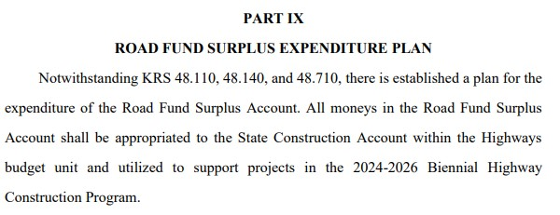
FY 2025 ROAD FUND
Surplus
From HB 6 (2024) – Executive Branch 2024-2026 Budget Bill
$61.6 million – FY 2025 Road Fund Surplus Expenditure Account
(State Construction Account)

Slide 7
INTERIM JOINT COMMITTEE
ON TRANSPORTATION
August 18, 2025
Road Fund Report
Mike Hancock, Deputy Secretary
Ron Rigney, Director of Program Management
Shaun McKiernan, Exec. Director of Budget & Fiscal Mgt.
- QUESTIONS -

Slide 8
BUDGET REVIEW SUBCOMMITTEE
ON TRANSPORTATION
August 20, 2025
Road Fund Report
Mike Hancock, Deputy Secretary
Ron Rigney, Director of Program Management
Shaun McKiernan, Exec. Director of Budget & Fiscal Mgt.
- QUESTIONS -

