Slide 1
INTERIM JOINT COMMITTEE
ON TRANSPORTATION
October 14, 2025
Kentucky’s Rest Areas
Jason Siwula, Deputy State Highway Engineer

Slide 2
Vision
Striving to be national leaders in transportation who provide transportation infrastructure and services for the 21st century that deliver new economic opportunities for all Kentuckians.
Mission
To provide a safe, efficient, environmentally sound and fiscally responsible transportation system that delivers economic opportunity and enhances the quality of life in Kentucky.

Slide 3
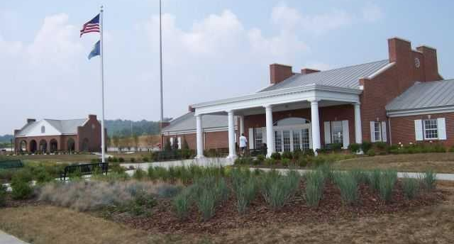
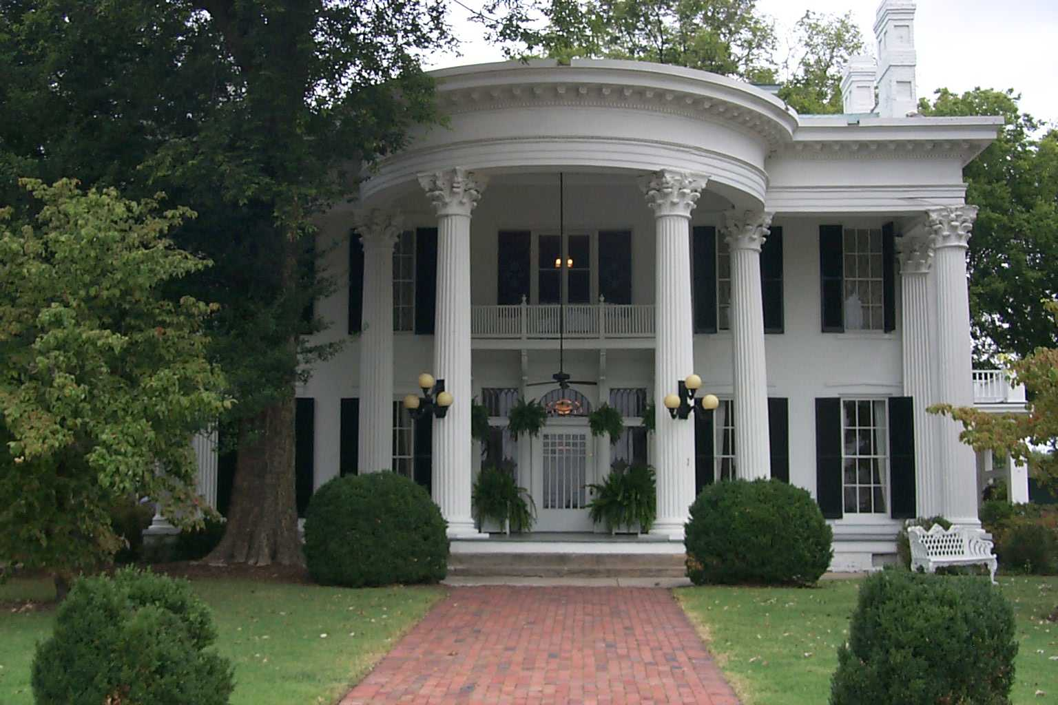
Rest Areas
Welcome Centers – 8
Rest Areas – 14
Truck Havens – 4
  Co-located with Weigh Stations
Maintenance Costs - $12.3M (FY 2025)
46% increase since FY 2021

Slide 4
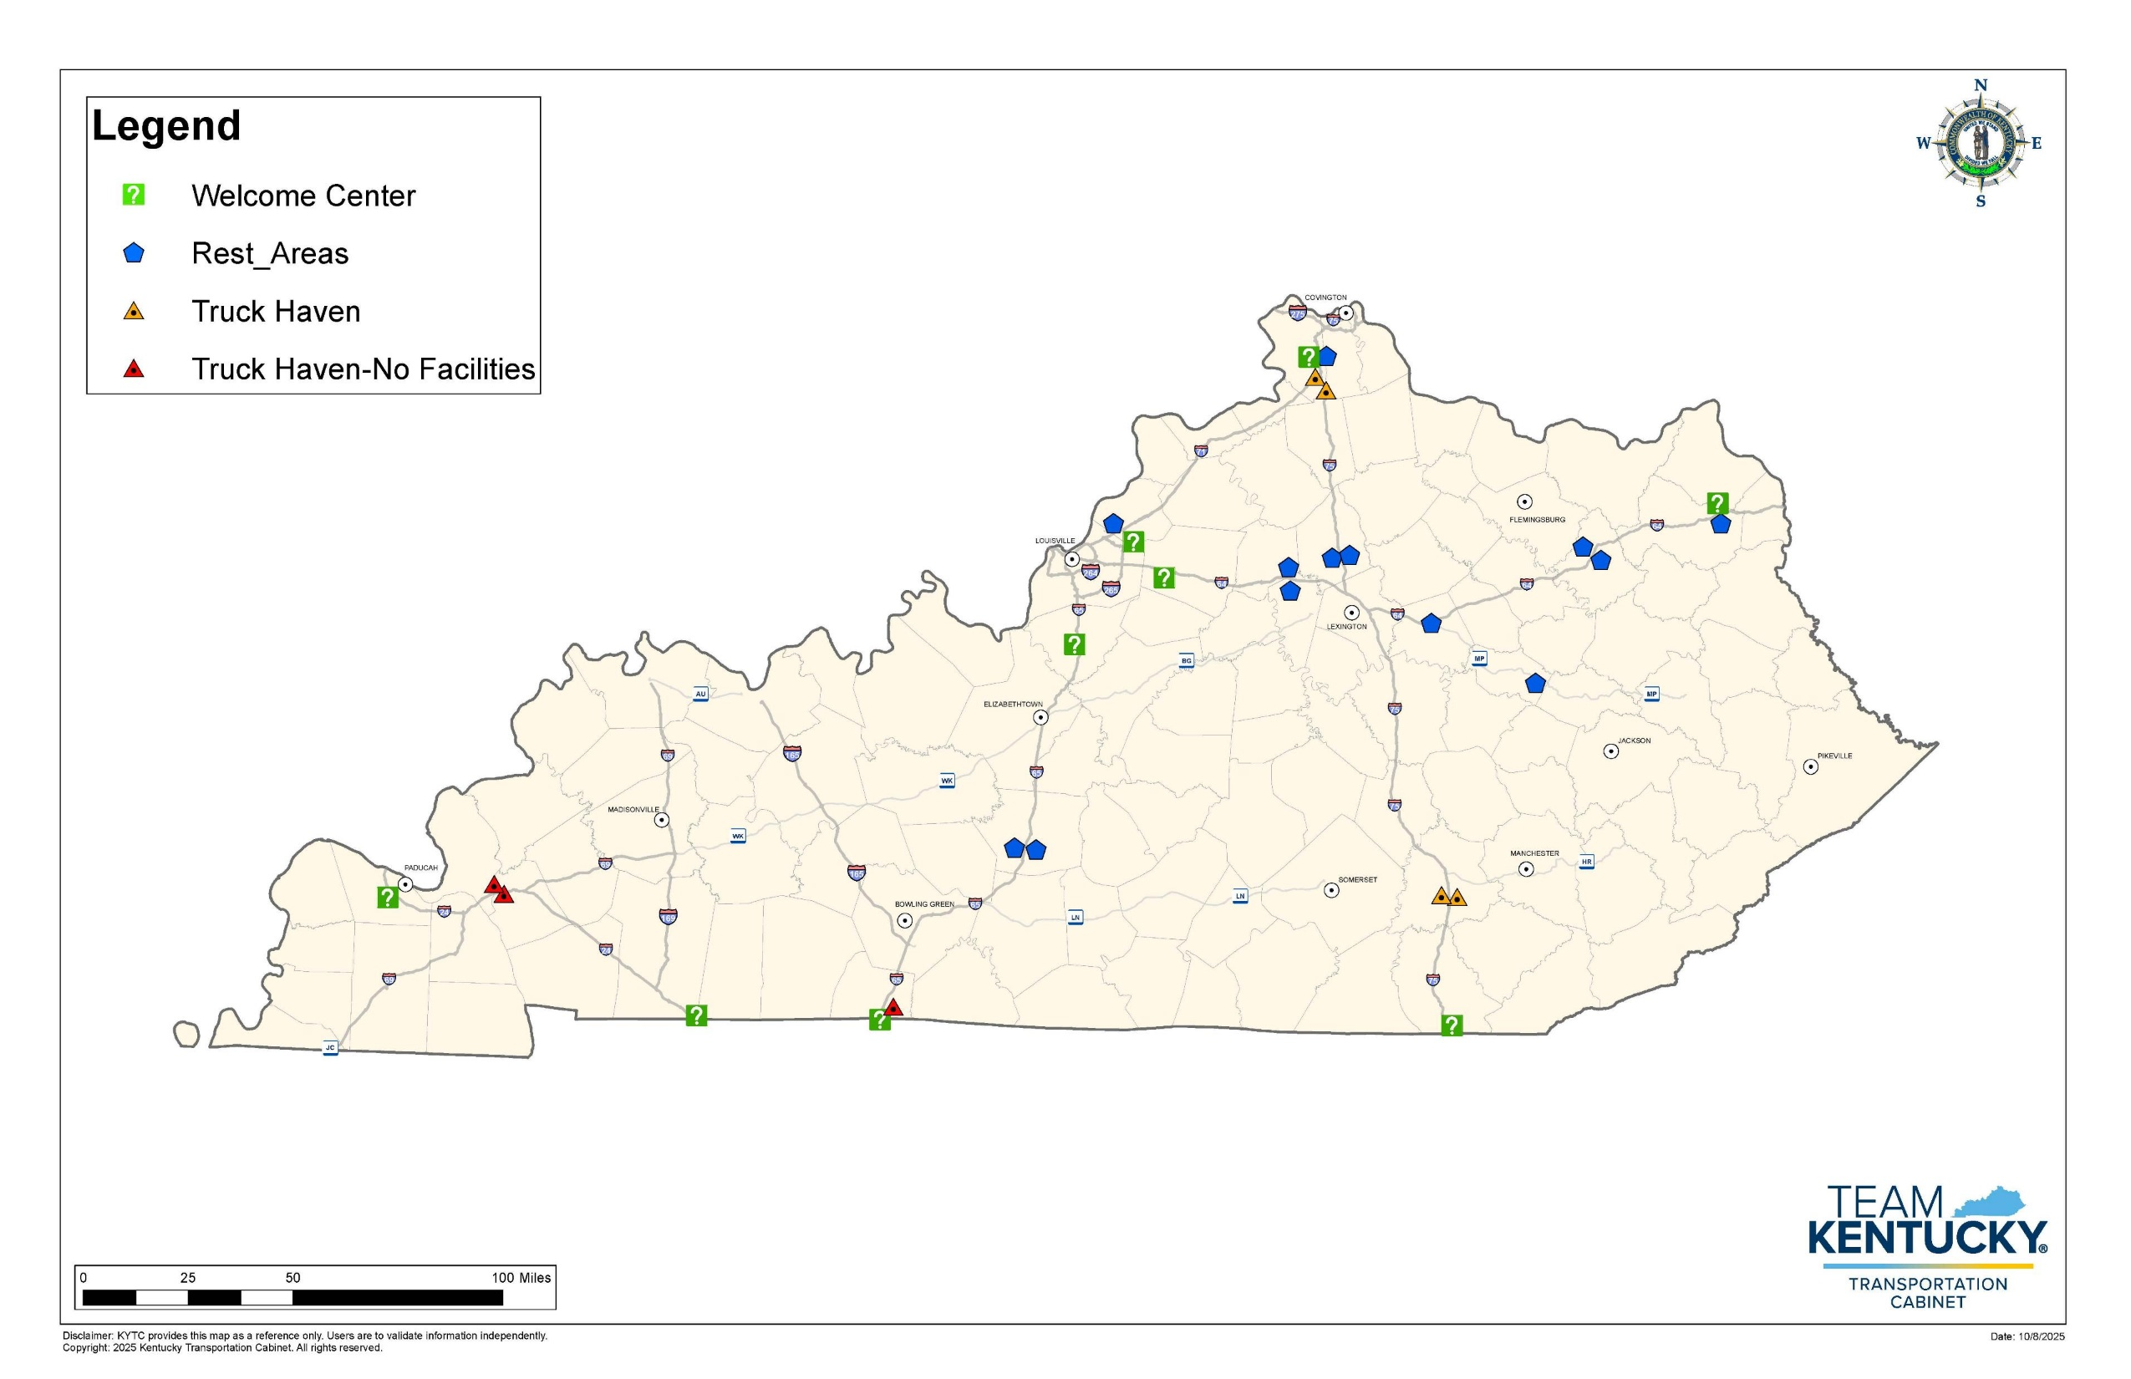

Slide 5
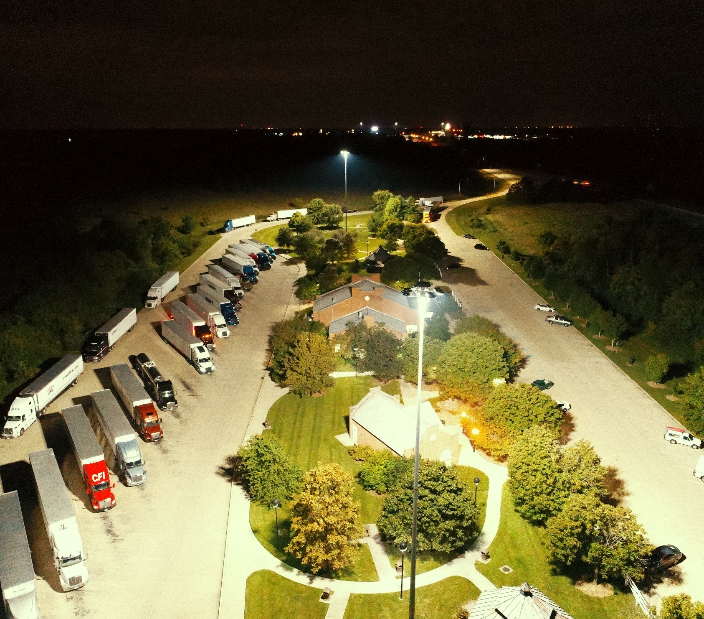
2022 Truck Parking Assessment
Demand increased 24% since 2012
Hours of Service Limitations
Electronic Logging
Fewer Drivers
Kentucky Truck Parking | KYTC
Notes:
Demand comparison is 10 years

Slide 6
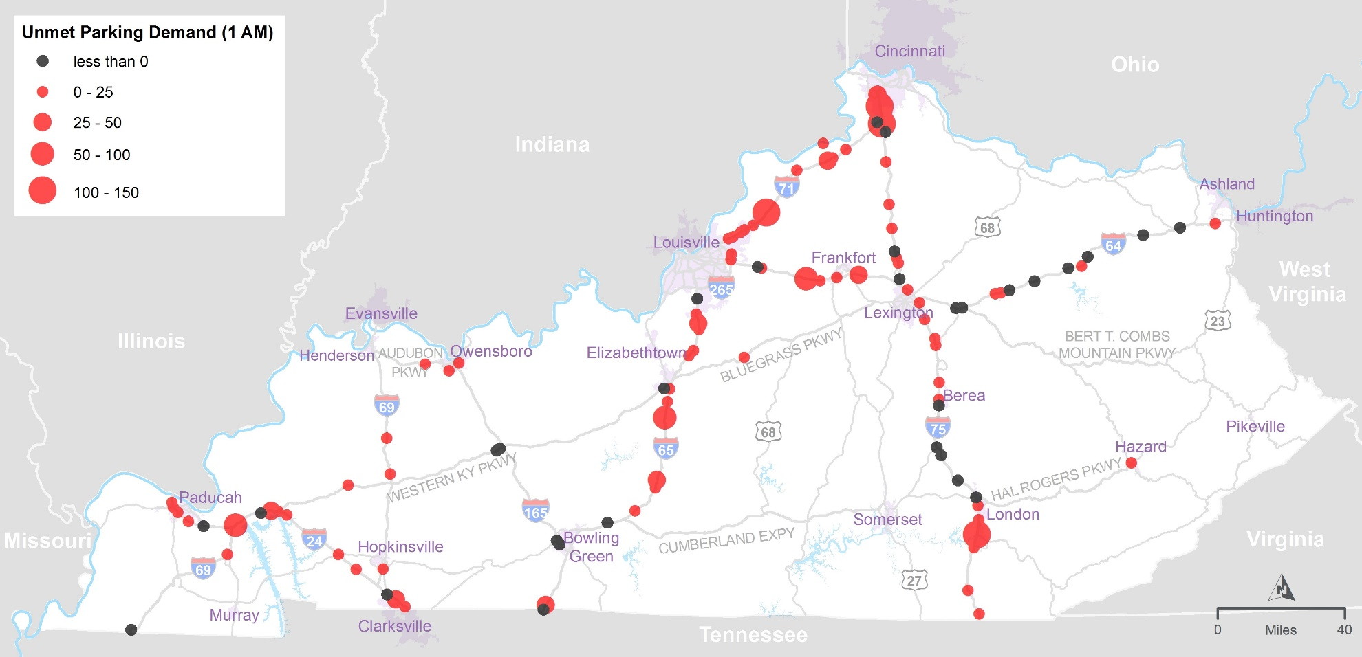
Unmet Parking Demand

Slide 7
Existing Truck Parking Supply
Facility Type | Number of Locations | Total Spaces | % of Total Spaces
Public Rest Areas | 23 | 820 | 10.6%
Public Weigh Stations | 14 | 413 | 5.3%
Privately Owned Truck Stops | 74 | 6,330 | 81.9%
Other Lots With Unclear Ownership | 15 | 170 | 2.2%
Box Store Parking Lots (e.g., Walmart, Lowes) | 81 | - | -
Highway Exit/Entry Ramps | 572 | - | -
Total | 779 | 7,733 | 100%

Slide 8
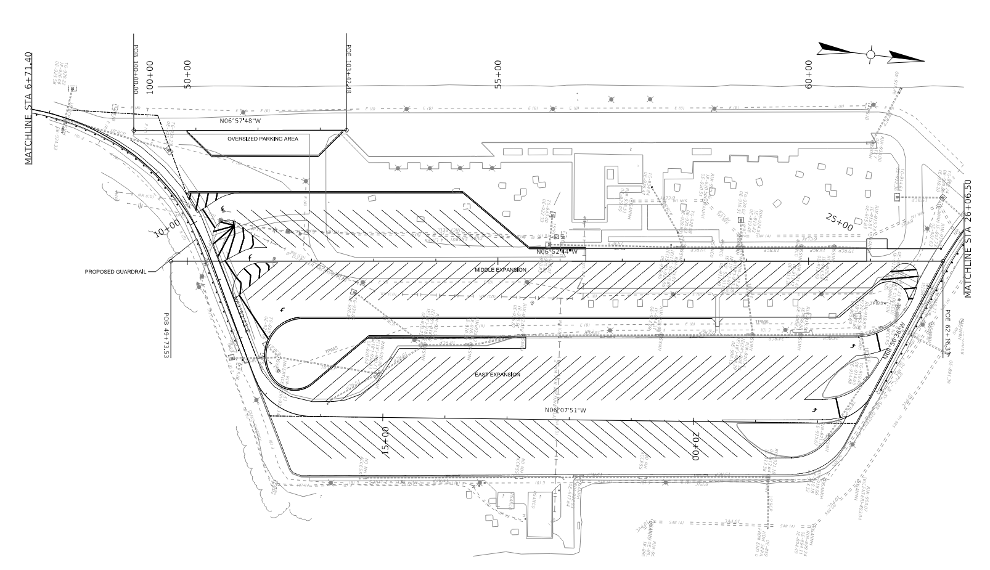
Truck Parking Action Plan
Truck Parking Expansion at 11 Sites
  Woodford EB & WB
  Simpson NB
  Bullitt SB
  Oldham NB & SB
  Boone NB & SB
  Scott NB & SB
  Whitley NB

Slide 9
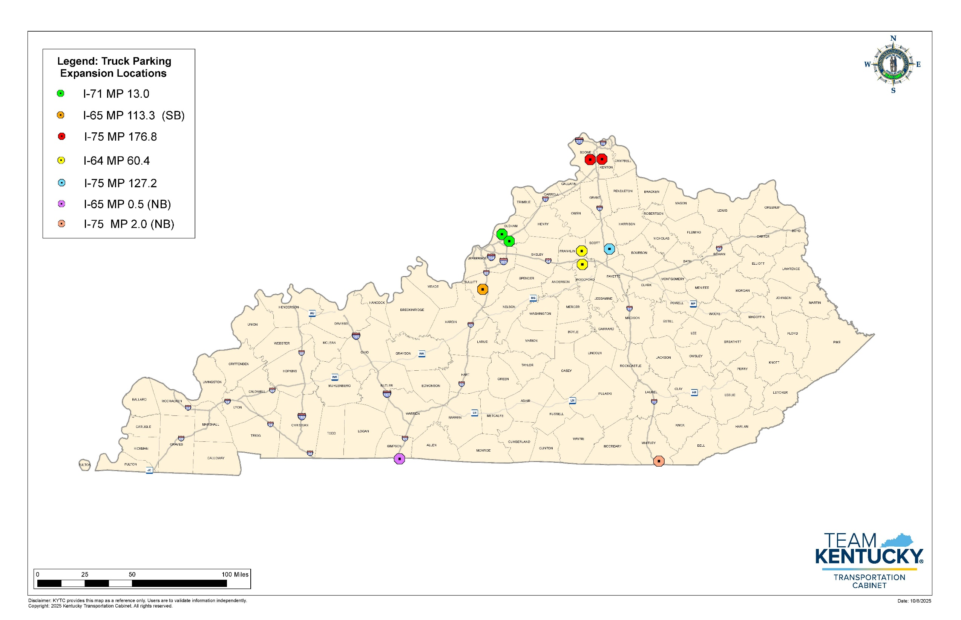

Slide 10
INTERIM JOINT COMMITTEE
ON TRANSPORTATION
October 14, 2025
Kentucky’s Rest Areas
Jason Siwula, Deputy State Highway Engineer
Jason.Siwula@ky.gov
502-229-8506
- QUESTIONS -

