Slide 1
INTERIM JOINT COMMITTEE ON TRANSPORTATION
November 4, 2025
Workzone Speed Enforcement
John Moore, Deputy State Highway Engineer
Jason Siwula, Deputy State Highway Engineer

Slide 2
VISION Striving to be national leaders in transportation who provide transportation infrastructure and services for the 21st century that deliver new economic opportunities for all Kentuckians.
MISSION To provide a safe, efficient, environmentally sound and fiscally responsible transportation system that delivers economic opportunity and enhances the quality of life in Kentucky.

Slide 3
Jared Lee Helton Act Goals
Improved Work Zone Safety
Enforce Work Zone Speed Limit
Safer Enforcement Beyond the Work Zone
Save Lives
Prevent Injuries
NOT for Revenue Generation

Slide 4
About the Jared Lee Helton Act
Requirements
Warning Signage
Flashers
Bona fide Worker
Speed Safety Cameras
Misconceptions:
No Mailed Citations
Not Always Active
Not a Money Maker

Slide 5
Camera Roll Out Plan
Small Initial Deployment - 5
Reviewing Impact
Developing Policy
Expanding in 2026
Current Deployment
Shelby – I-64
Laurel/Whitley – I-75
Martin – KY-3
Fayette – KY-418

Slide 6
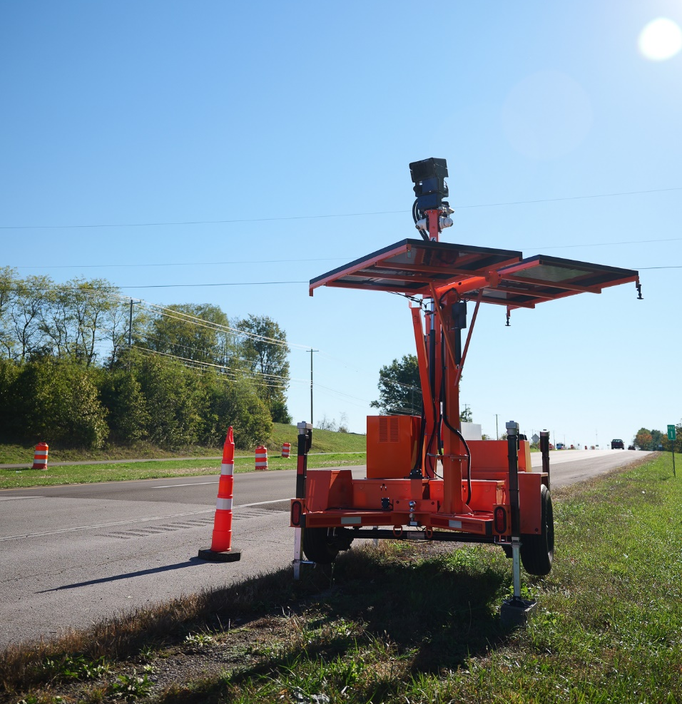
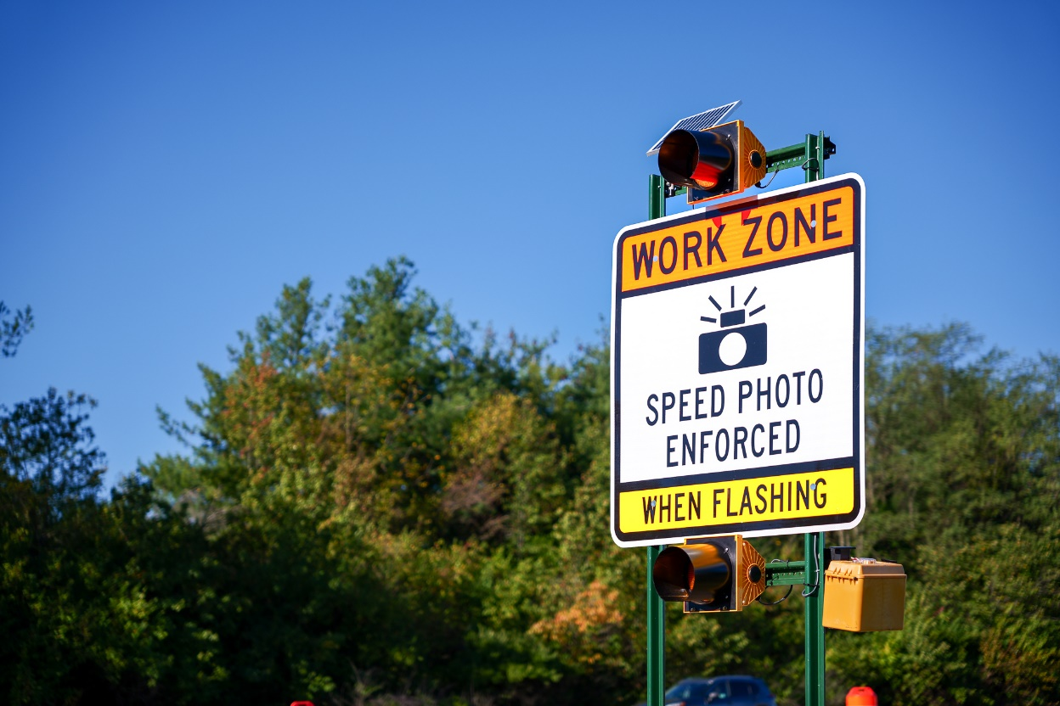
Warning Signs and Workzone Camera

Slide 7
INTERIM JOINT COMMITTEE ON TRANSPORTATION
November 4, 2025
Workzone Speed Enforcement
John Moore, Deputy State Highway Engineer
Jason Siwula, Deputy State Highway Engineer
- QUESTIONS -

