Slide 1
Implementation of
HB 571
Interim Joint Transportation Committee
Presentation by John Moore
Frankfort, Kentucky | August 4, 2026

Slide 2
Vision
Striving to be national leaders in transportation who provide transportation infrastructure and services for the 21st century that deliver new economic opportunities for all Kentuckians.
Mission
To provide a safe, efficient, environmentally sound and fiscally responsible transportation system that delivers economic opportunity and enhances the quality of life in Kentucky.

Slide 3
Highway Lighting
Nighttime Crash Rate 3X Daytime Rates
Roadway Lighting Proven to Reduce
  Nighttime pedestrian crashes at intersections by 42%
  Nighttime intersection crashes by up to 38%
  Nighttime injury crashes on highways by 28%
Proven Countermeasure

Slide 4
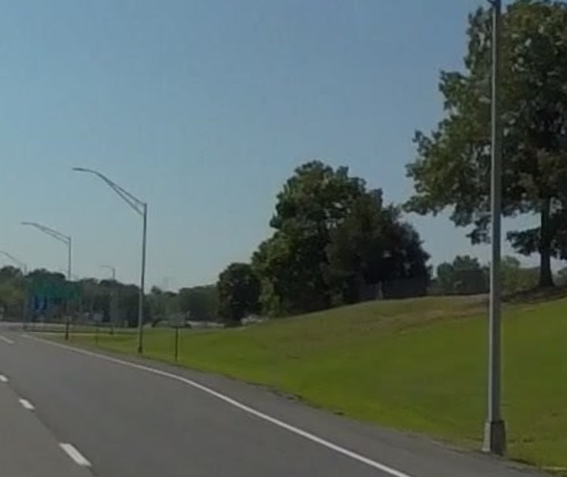
Types of Lighting
Cobra Head
  ~12,000 Statewide
  Small Light Footprint
  Roadway Adjacent
  Lower Initial Cost
  $12,600 per fixture
  Higher Maintenance Cost
  ~40 per interchange

Slide 5
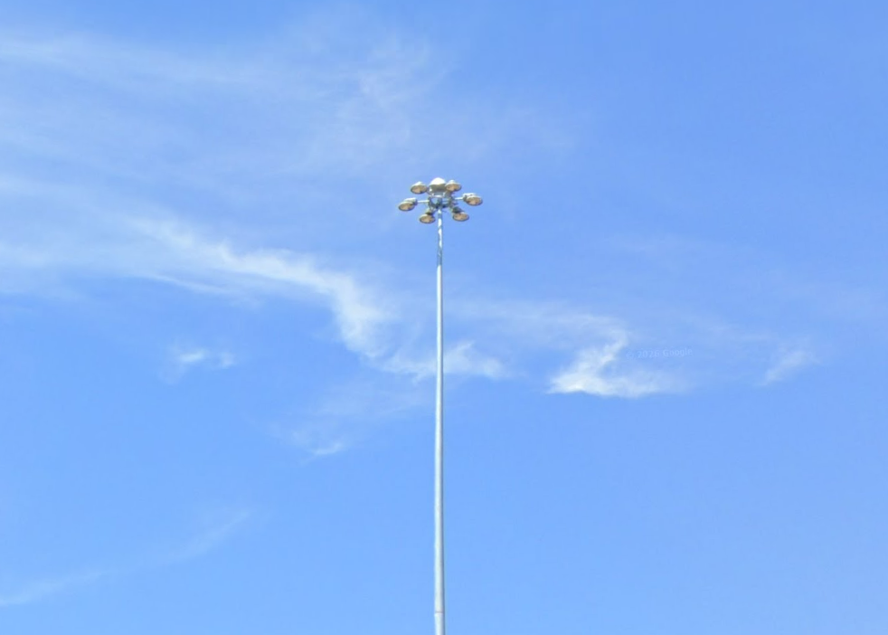
Types of Lighting
High Mast
  ~6,000 Statewide
  Larger Light Footprint
  Outside the Clear Zone
  Higher Initial Cost
    $103,000 per fixture
  Lower Maintenance Cost
  ~8 per interchange
  Only used on interchanges

Slide 6
RS 26 HB 571
The cabinet shall not allow light emitted from an outdoor light fixture to encroach on any agricultural land, whether public or private.
Any new outdoor light fixture installed after the effective date of this Act which emits light that encroaches on agricultural land shall be fully shielded at the time of installation.

Slide 7
RS 26 HB 571 (cont’d)
If light emitted from an outdoor light fixture encroaches on agricultural land, the owner of that land may submit a complaint in writing to the cabinet, and the cabinet shall ensure that the outdoor light fixture is fully shielded within thirty (30) days of the date of the submission of the written complaint.
This section shall not apply to outdoor light fixtures used by the cabinet or its contractors incidental to a highway construction or maintenance project, provided the encroachment lasts for no longer than one hundred eighty (180) days and that the lights are turned off when not in active use for construction or safety purposes.

Slide 8
New Lighting Policy
Lighting policy updated to match KRS 176.056
  No lighting spill-over onto adjacent agricultural lands.
Working on strategies to meet requirement
  Light Shields
  Dim Fixtures
  Change Lighting Type
May require omitting lighting on some projects

Slide 9
Existing Lighting
Landowners Contact Local KYTC Office with Concern
Potential Mitigation
  Enhanced Shielding
  Reduce Intensity for Nearby Fixtures
  Disengaged Fixtures

Slide 10
Potential Improvements
Solar Lighting
  Limited Use
Adaptive Roadway Lighting
  Communication Devices Required
Modify Lighting Warrants
  Context Sensitive

Slide 11
John Moore, PE
Deputy State Highway Engineer
Transportation Cabinet
502-782-5053

