Slide 1

Department for Highway Safety
Interim Joint Committee on Transportation
October 6, 2026

Slide 2
Mission Statement
The Kentucky Office of Highway Safety, within the Kentucky Transportation Cabinet, operates with the following mission: To enhance the lives of those who use Kentucky’s transportation system by preventing crashes that result in deaths and serious injuries.
We have learned it takes all the E’s:
-Enforcement
-Education
-Engineering (Roadside Safety Assessments)
-Emergency Medical Services (EMS)

Slide 3
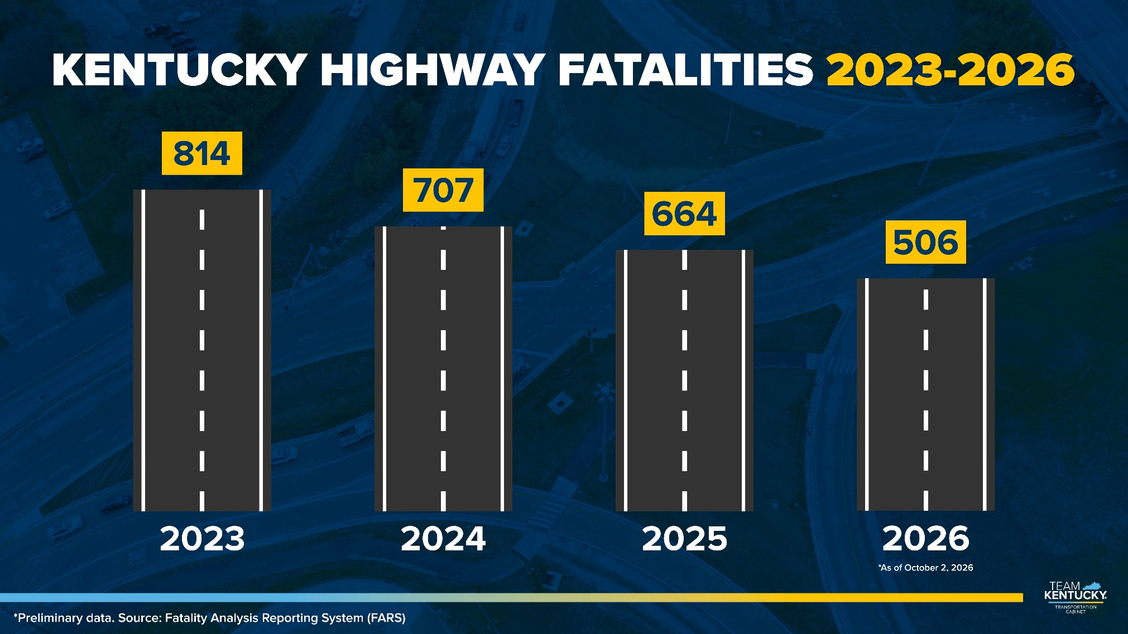

Slide 4
2026 Daily Fatality Summary
Fatalities for 2026 as of Oct. 2: 506 / same time last year: 519
84 Alcohol related (not including drugs)
161 not belted
Commercial motor vehicle-involved: 51
Motorcycle: 71
Pedestrian / Non-Motorist: 68

Slide 5




It’s about people.
Safety isn’t really about numbers…
TRANSPORTATION.KY.GOV

Slide 6
Work zone Camera
NEXT STEPS
Deploy 7 new systems
Identify locations through a data driven approach
Expand project to other law enforcement
Continue to monitor progress

Slide 7

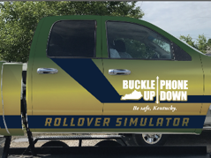
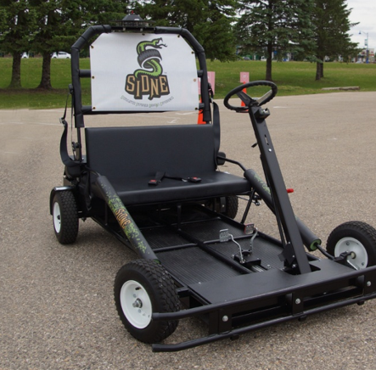
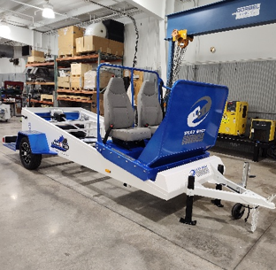
Education ProgramS
Occupant Protection
  Rollover Simulator
  Presentations
  Seatbelt Convincer
Young Drivers
Impaired Driving
  Ghost Out
  Drunk & Drugged Driving Simulator
  Presentations
  SIDNE Karts
Distracted Driving
  Presentations
  Arrive Alive Tour Program (Granted thru KOHS)
  Choices Matter Program(Granted thru KOHS)

Slide 8

SAFE KENTUCKY TEEN DRIVER CHALLENGE
Teen drivers competed for $10,000 in total prize money, with individual awards of:
1st Place: $3,000
2nd Place: $2,500
3rd Place: $2,000
4th Place: $1,500
5th Place: $1,000
This challenge was supported by our great partners from Intoximeters, AAA Bluegrass and AAA East Central.

Slide 9
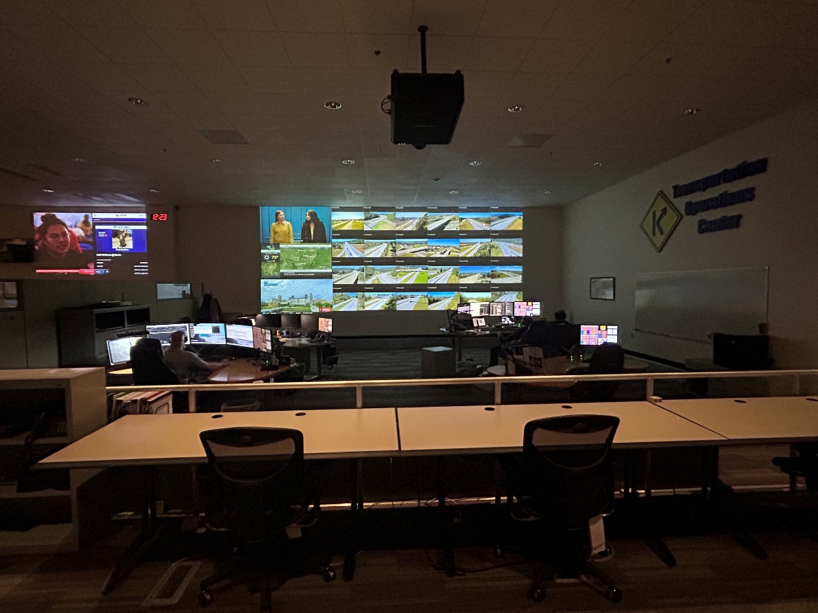
Incident Management
Transportation Operations Center

Slide 10
Transportation Operations Center
Receive and distribute notifications of incidents occurring on all State Highways, Federal Routes, Parkways and Interstates 24/7/365
  Reports are received via:
    Local and County Governmental agencies
    KYEM Duty Officer reports
    KSP Via CAD sharing or Road Closure Reports
    General Public
    Camera Network

Slide 11
Transportation Operations Center
Dissemination of Information
  Populates the Go KY public website
    -Information is shared with navigation platforms
  Send traffic incidence notices through e-mails
    -Internal and external distribution of e-mails for KYTC groups
DMS Messaging

Slide 12
Transportation Operations Center
After-hours Point of Contact
  KYTC District personnel call-outs
    Debris removal, Signal Issues, Snow & Ice, etc..
  Fleet Management
    Flat tires, lockouts, collisions, etc..
  Division of Driver Licensing
    Fraud report inquiries from Law Enforcement

Slide 13
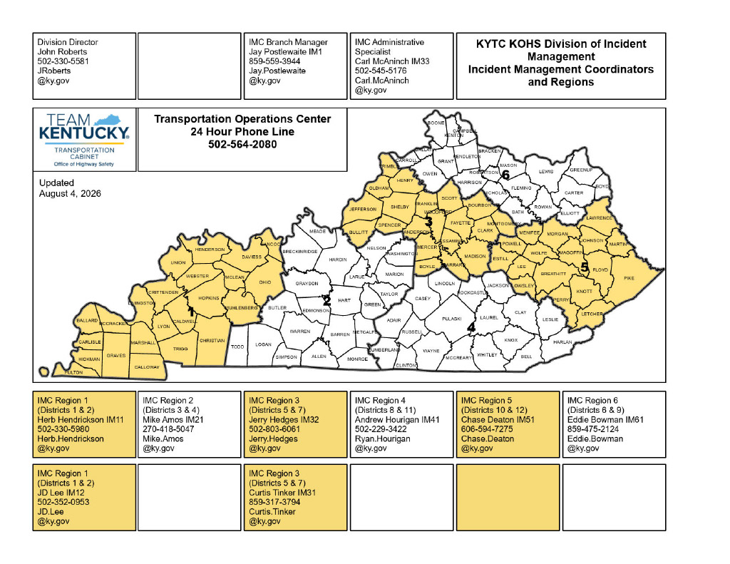
Incident Management Coordinators

Slide 14
Incident Management Coordinators
Ensure all response entities have the needed assets to manage incidents that occur
Respond to scenes to assist as needed
Represent the Cabinet in any Incident Command Structures
Assist with multi-agency coordination
Provide accurate and detailed information
Provide training for KYTC and partner response agencies
Schedule, assist and facilitate After-Action reviews

Slide 15
Incident Management Coordinators
Provide training for KYTC and partner response agencies
Attend functions and remain active with Partner Response Agencies
Building Relationships and Strengthening Response Planning
Represent KYTC during activations of the State Emergency Operations Center

Slide 16
QUESTIONS?

