Slide 1

Interim Joint Transportation Committee
Heather Stout, Executive Director OIT
October 6, 2026

Slide 2
KDLIS Legacy Modernization
~40 year old legacy mainframe system
RFP Released – May 2024
Project kickoff – February 2025
Vendor – Fast Enterprises (40+ team members onsite)
Project Go-Live – June 2026
  Data conversion activities from 6/4 - 6/5
  Interface partners connected on 6/6
  AAMVA connection certified on 6/7
  Soft launch performed in 36 regional offices on 6/7
    266 transactions performed

Slide 3
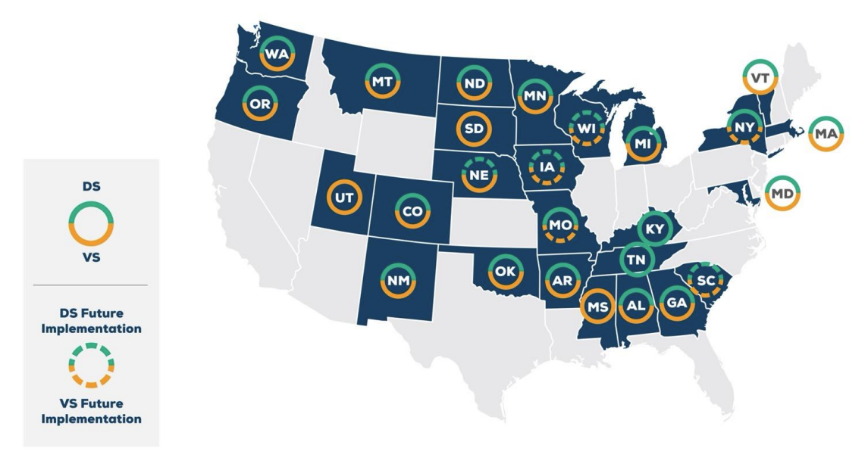
FAST Driver and Vehicle Services (DS/VS) Projects
In 26 States
  23 Driver Services
  24 Vehicle Services

Slide 4
KINDL Project Introduction and Objectives
Decommissioning an aging mainframe system and replacing with a modern, configurable cloud-based system
Reduced wait times and improved customer satisfaction
Enhancing the availability and shareability of data with authorized internal and external users
Streamline workflows, eliminate manual workarounds and reduce learning curve
Enhanced/expanded digital services for customers
Advanced and improved auditing and reporting capabilities
Speed up compliance with state-to-state requirements and federal mandates

Slide 5
Decommissioning an aging mainframe system and replacing with a modern, configurable cloud-based system
~5.5 million individual records migrated to KINDL
~5.1 million credentials migrated to KINDL
~1 million driver sanctions converted to KINDL
~1.4 million driver verdicts converted to KINDL
Reduced wait times and improved customer satisfaction
Average Transaction Time
Average Wait Time
Month | Transaction Count | Average Transaction (In Minutes)
June | 92,112 | 6.04
July | 131,007 | 5.50
August | 128,355 | 5.05
September | 119,571 | 4.98
Month | Wait Time (walk-ins) | Wait Time (appts)
June | 19 mins | 12 mins
July | 13 mins | 10 mins
August | 9 mins | 10 mins
September | 8 mins | 7 mins

Slide 6
Streamline workflows, eliminate manual workarounds and reduce learning curve
Replaced manual SAVE document review with systematic interface
30 Distinct Approval processes to streamline supervisor/central office review
36 Transaction Types that provide distinct workflows that guide users
Built in system Help manager for user reference and ongoing documentation
Enhancing the availability and shareability of data with authorized internal and external users
Kentucky Driver Access Portal (KDAP) enables external agencies to obtain more controlled access to necessary data
Advanced and improved auditing and reporting capabilities
Improved speed in obtaining and building reports
Ad hoc reporting and filtering capabilities
Speed up compliance with state-to-state requirements and federal mandates
Joined AAMVA's State-to-State Pointer Exchange System (SPEXS) and Driver History Record (DHR) programs

Slide 7

Enhanced/expanded digital services for customers through myDrive
Enhanced account verification process
  Letter ID required for identity verification
myDrive stats
  139,970 Web logon accounts created
  51,000+ Online transactions performed since June 7th
Transaction Type | Count
New! Pre-apply for card | 36,188
New! General Document Submission | 1,168
New! Replace card | 5,710
New! Change mailing/residential address | 1,193
Renew card | 6,395
Pay Reinstatement Fees | 452
Ignition Interlock Application | 65

Slide 8
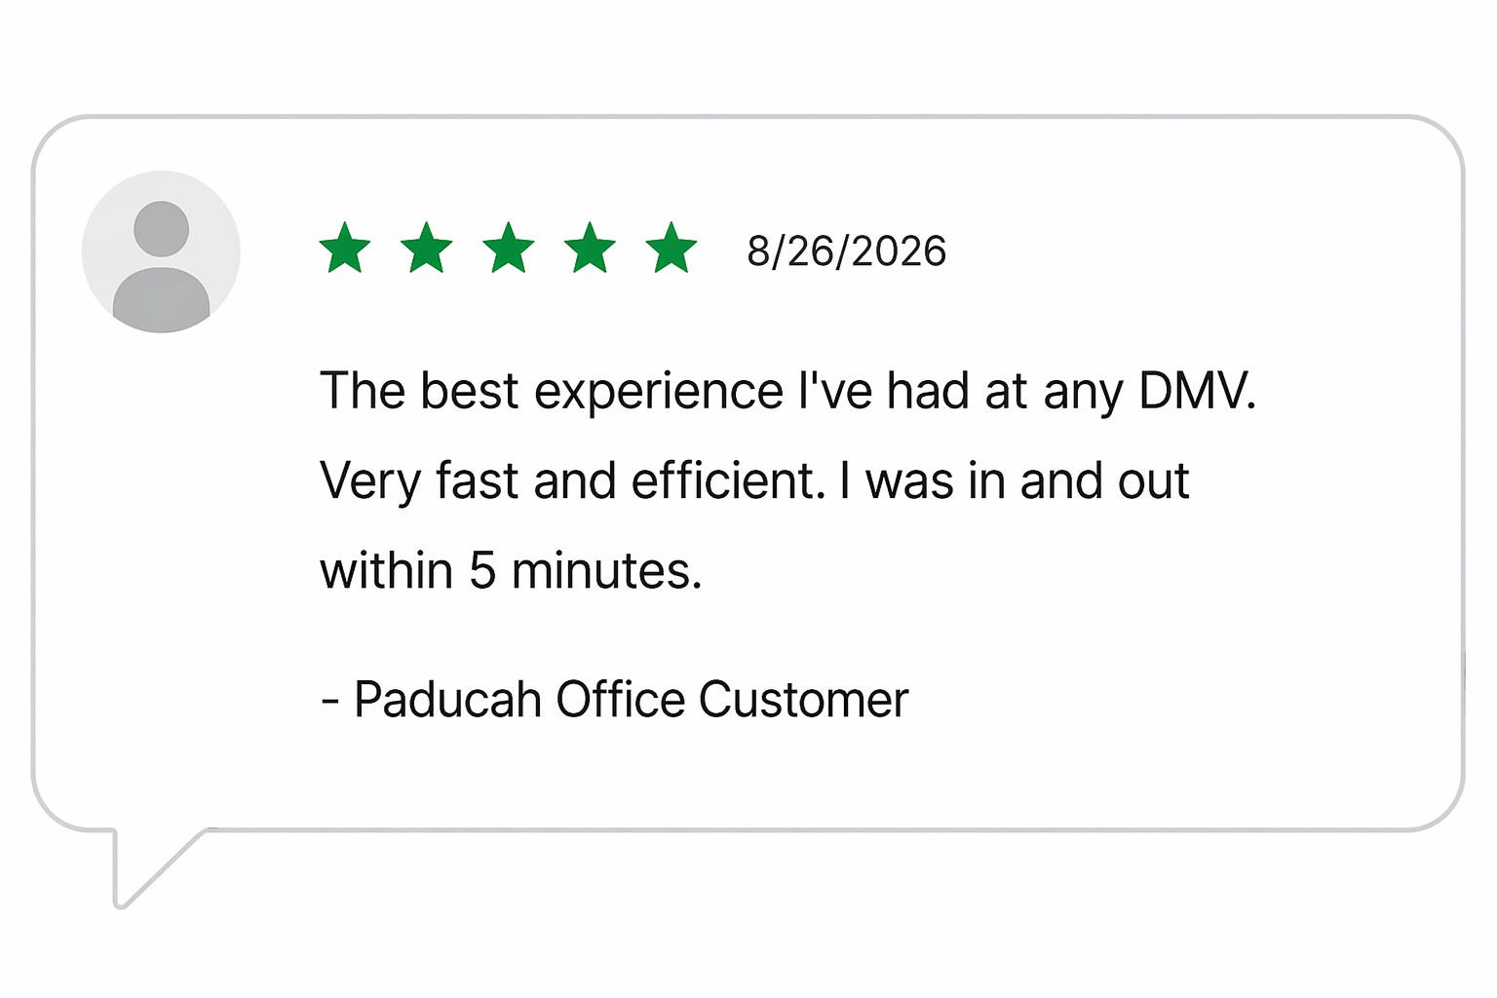
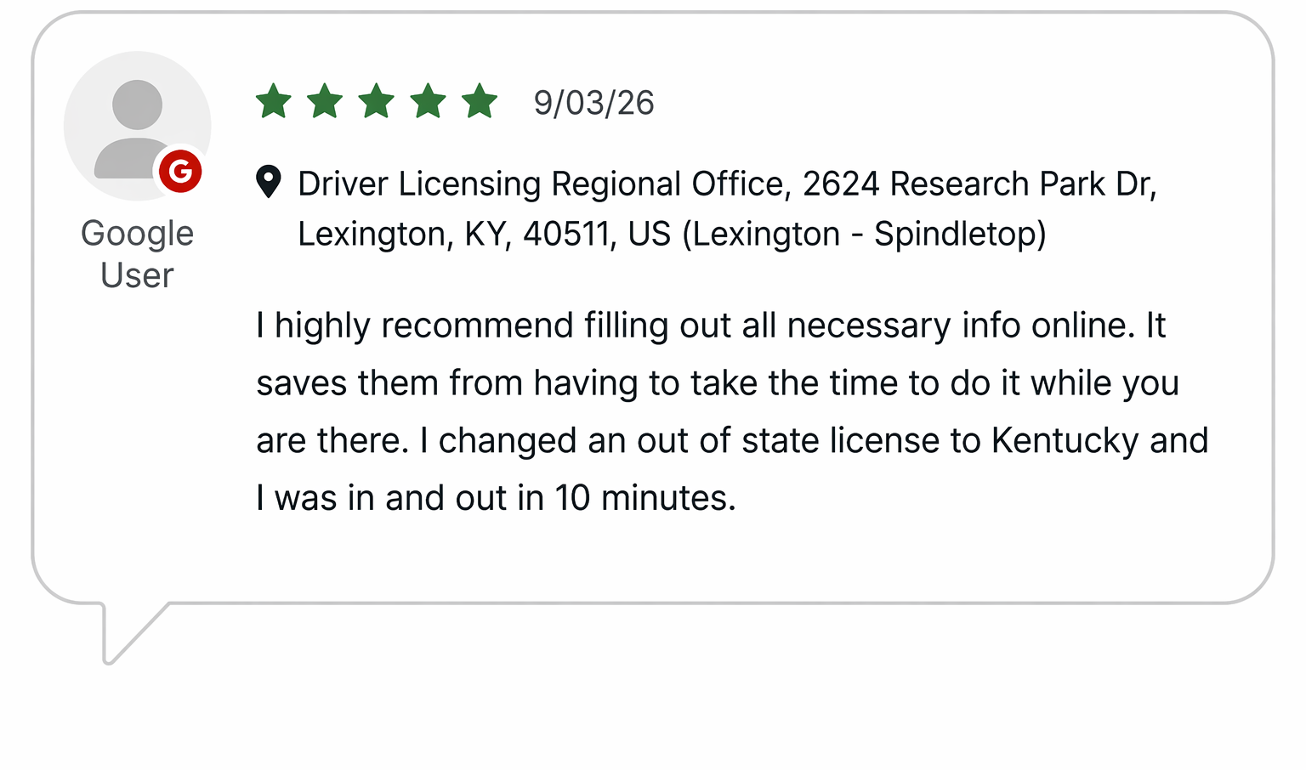
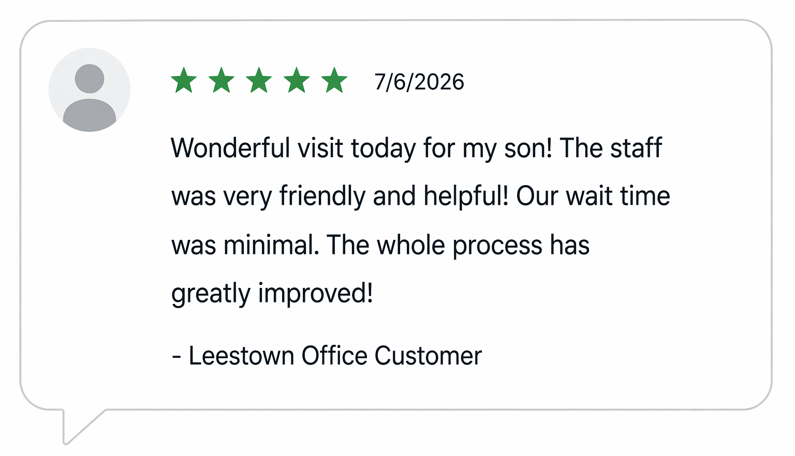
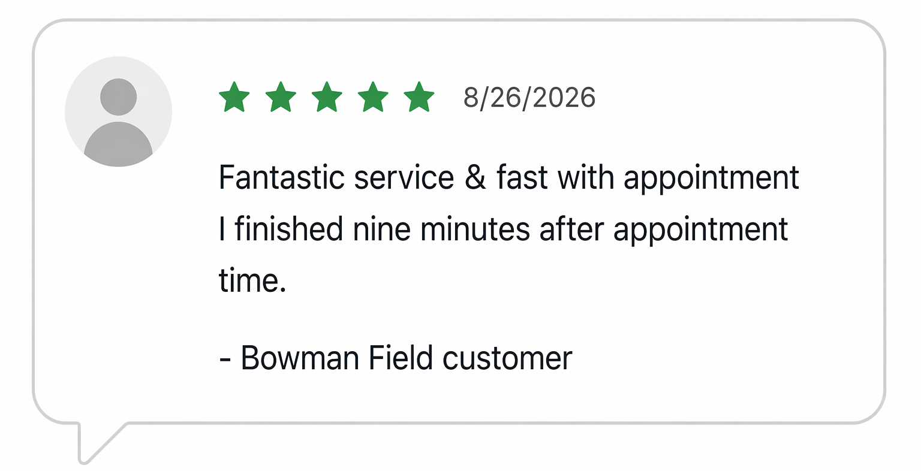
Staff and Customer Feedback

