Slide 1
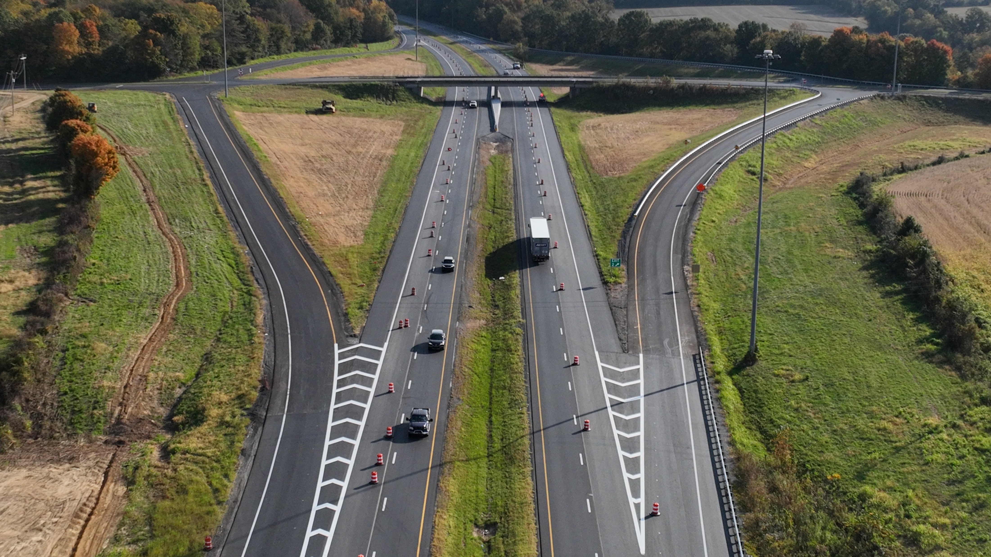

Frankfort, KY | October 2026
Interim Joint Committee on Transportation
Driver Licensing Regional Offices:
Where we are now

Slide 2
Division of Driver Licensing (DDL): Who We Are
35 Driver Licensing Regional Offices (DLROs) serving Kentuckians statewide
More than 1.3 million credentials issued in 2025
Services include:
  Driver licenses and permits
  REAL ID credentials
  Commercial Driver Licenses (CDLs)
  Identification cards
Focus: secure credentials, convenient locations, and a better customer experience

Slide 3
Our Driver Licensing Regional Offices
Each of our DLROs are a combination of:
  Appointments
  Walk-in service
  Online services
  Partnership with KSP for driver testing
Continuous review of all locations to meet growing demand and evolving needs
Additional office expansion in the works for Oldham, Shelby, and Bullitt counties
Goal: bring driver licensing services closer to Kentucky communities

Slide 4
Improving the Customer Experience
Making it easier and faster to get a credential
  Significant reductions in customer wait times
  Online services through MyDrive
  Appointment scheduling through our online queuing system
  Encouraging customers to use 8-year renewal options when eligible
  REAL ID services available statewide
  Continued focus on accessibility, efficiency and customer service
Key result: DDL is moving from a traditional transaction-based model toward a more customer-centered service model.

Slide 5
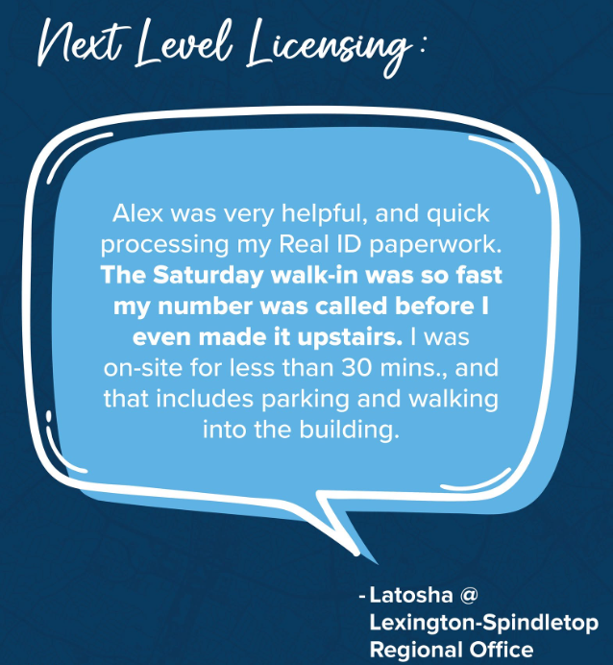
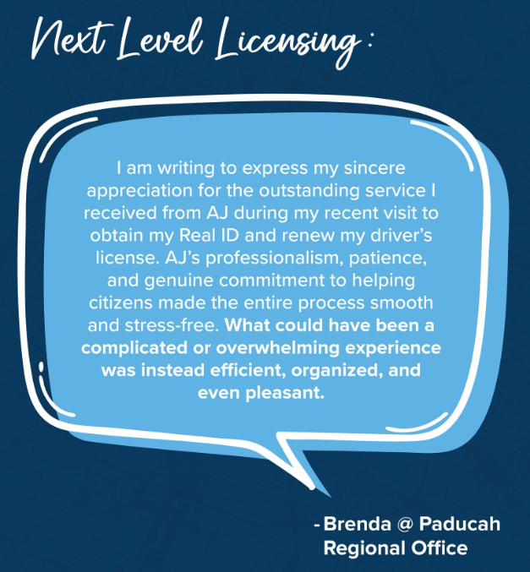
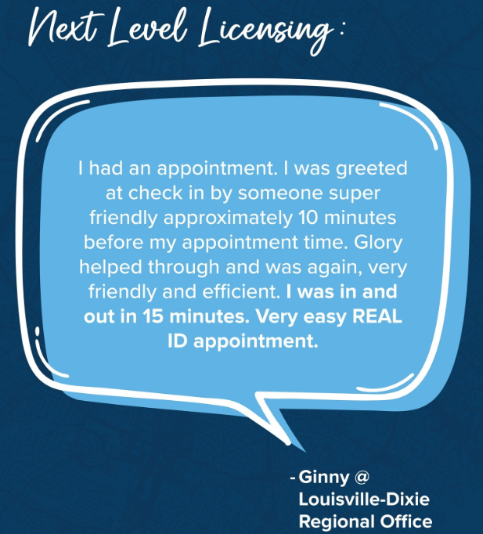
What people are saying

Slide 6
Programs That Serve Kentuckians
DDL – Yes, we do these things too
  Inmate Reentry Program
    Provides credentials to eligible individuals before release
    Partnership with Kentucky Department of Corrections and the Justice Cabinet
  Mobile ID (mID)
    Digital credential option for participating Kentuckians
    Supports identity verification and convenience
  REAL ID
    More than 50% of Kentucky credentials are now REAL ID compliant
  CDL Services
    Commercial licensing, testing and credentialing
    Strong coordination with KSP and federal partners
  Donor Registration
    Driver licensing customers can register as organ, eye and tissue donors

Slide 7
Looking Ahead
Building the next generation of driver licensing
  Continue expanding access to DLRO services
  Expand digital and self-service options
  Continue very low customer wait times
  Strengthen credential security and fraud prevention
  Improve coordination with law enforcement and federal partners
Develop additional services that allow customers to complete more transactions without visiting an office

Slide 8
Closing message
DDL's mission is simple: provide Kentuckians with secure, accessible and convenient driver licensing services — wherever they live and however they choose to interact with us.
With our expanded DLRO network, modern technology, digital services and customer-focused programs, DDL is building a strong driver licensing program designed for the future of Kentuckians.

Slide 9
Want more information?
Please visit DRIVE.KY.GOV
QUESTIONS?
Matthew Cole
Commissioner
Department of Vehicle Regulation
Matthew.cole@ky.gov

